Slide 1



Slide 2

Deliverable: AV EDGE will refer economic development leads to the City within one week.
Leads Generated This Quarter: 1
Status: Q2: 25% of goal. YTD: 50% of goal.
LEAD GENERATION

Slide 3
2. COMMERCIAL &
INDUSTRIAL
VACANY LISTINGS
Deliverable: AV EDGE shall maintain a comprehensive and up-to-date listing of commercial and industrial properties available throughout the region and report regularly on the number of new listings, removed listings and active listings
Status: Q2: 25% of goal. YTD: 50% of goal.
Website Updates Completed: The site is updated every other week.

Slide 4
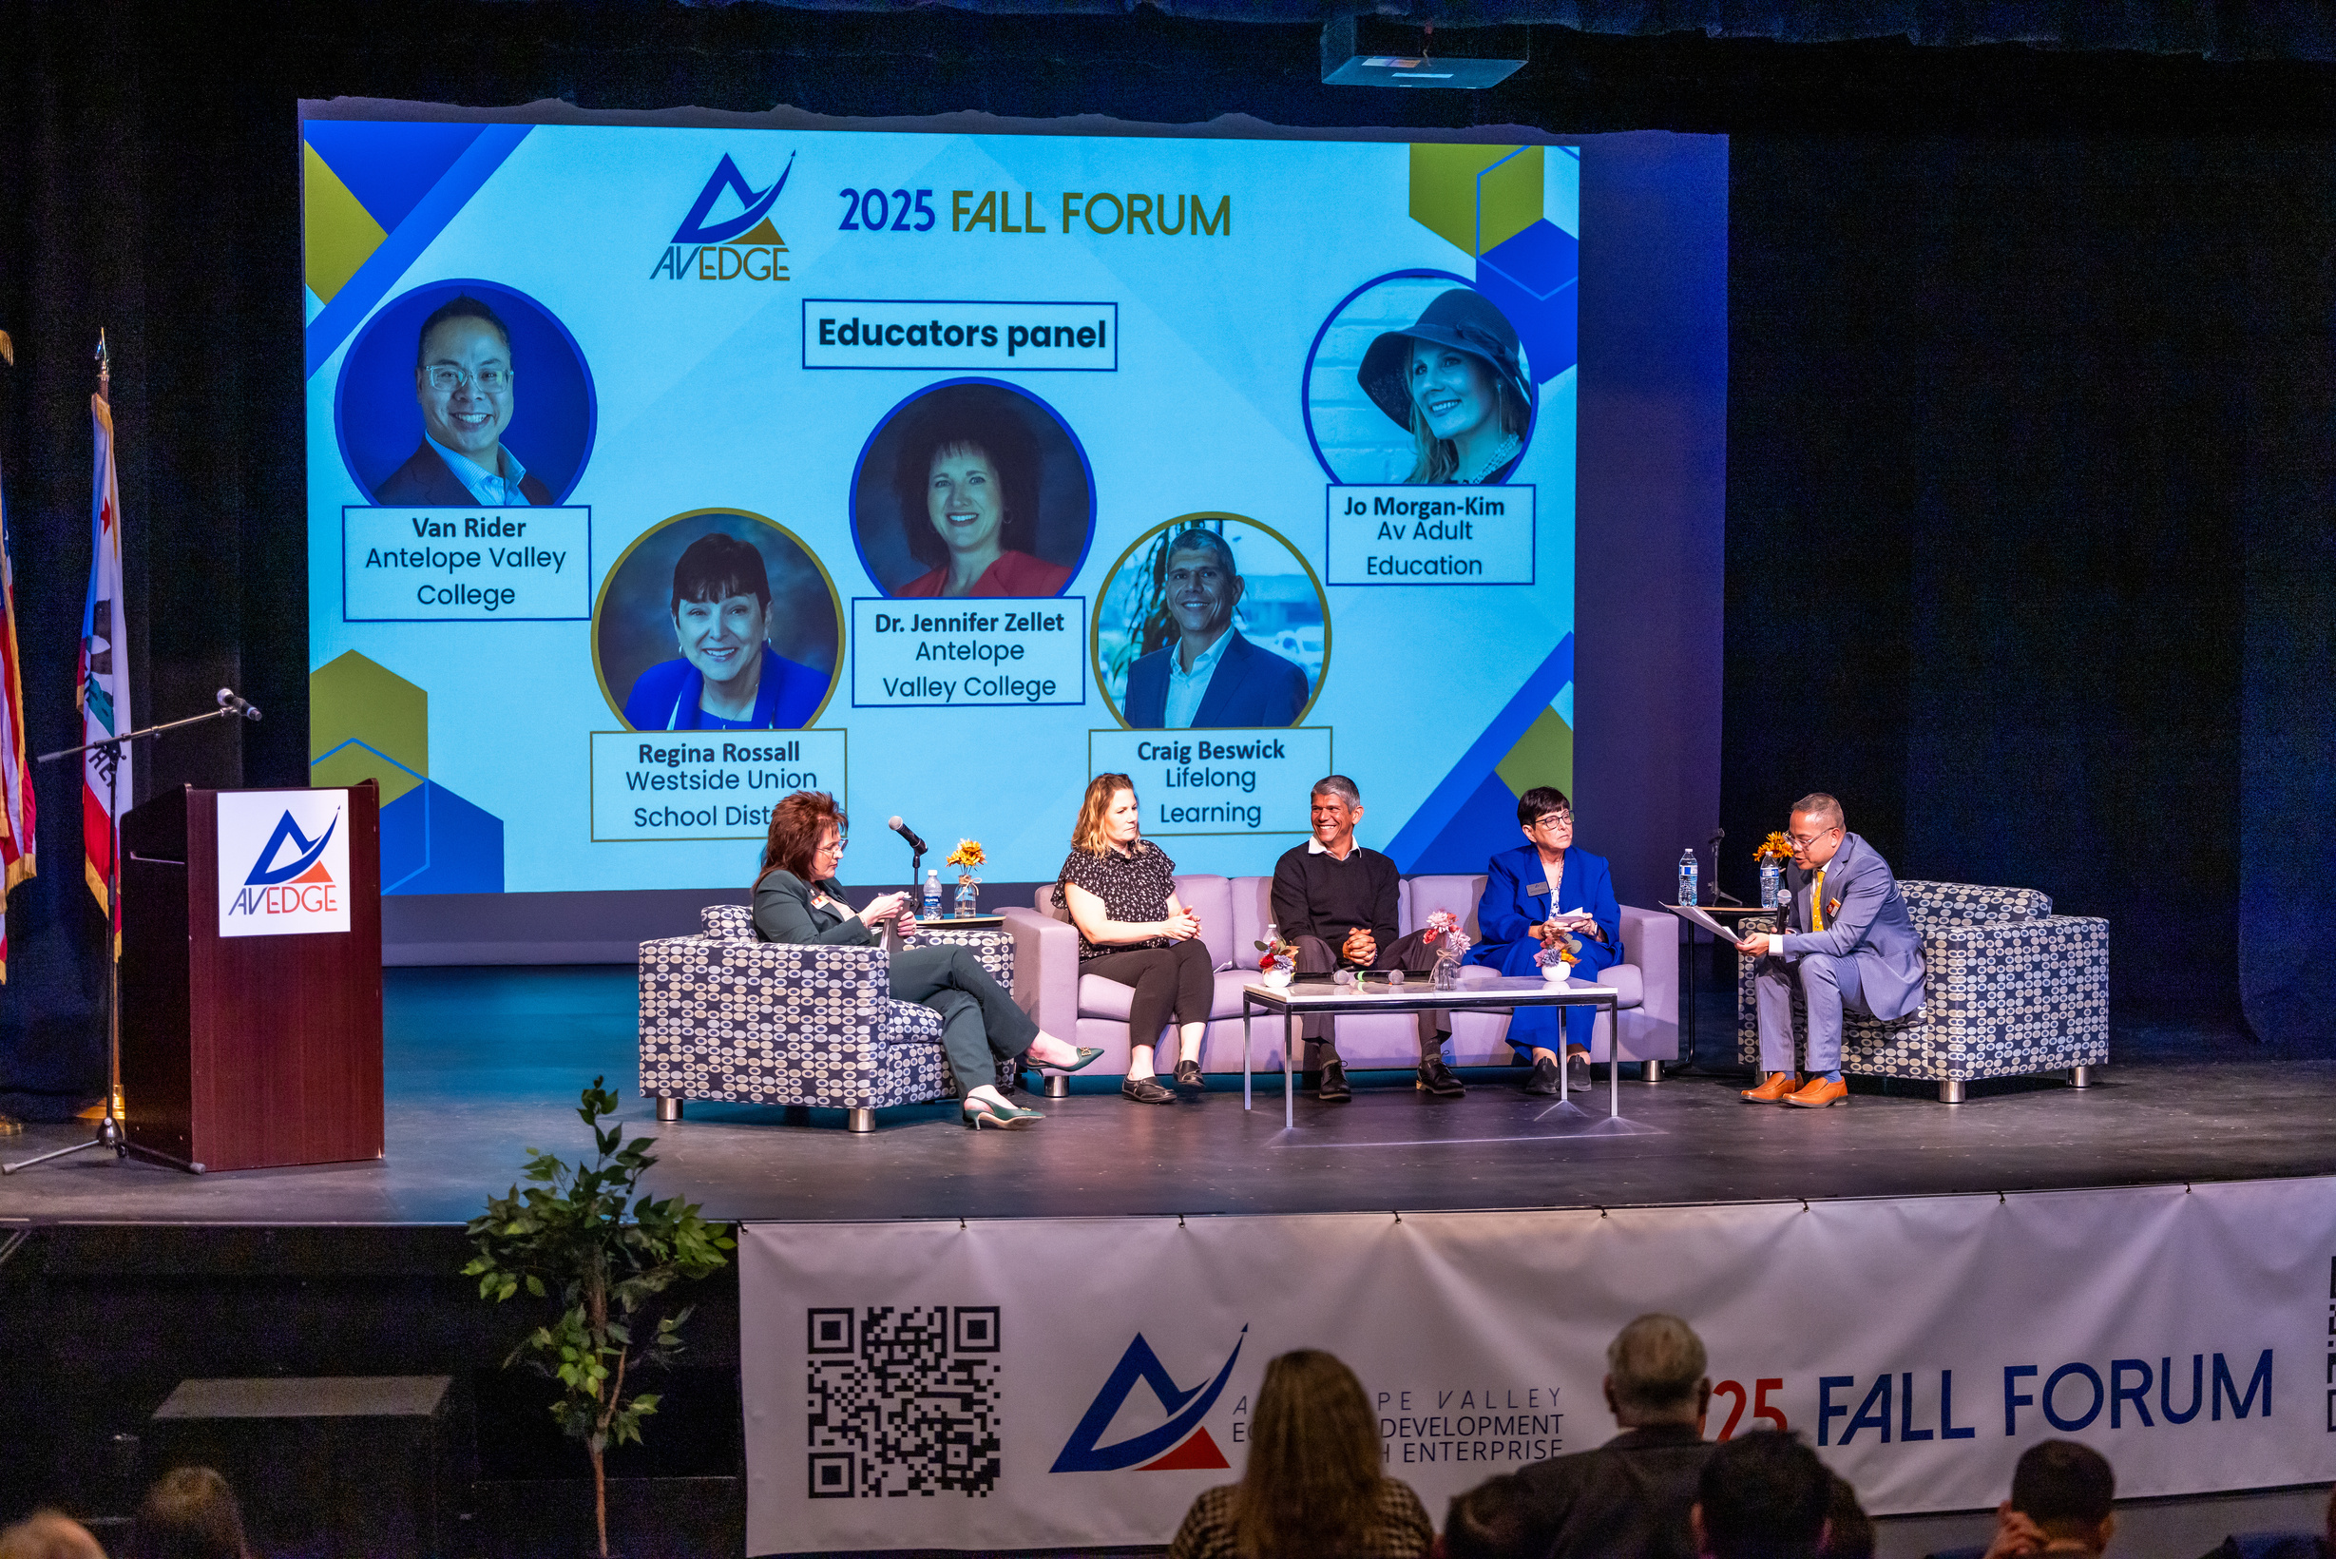
Deliverable: AV EDGE shall host two economic development forums per year, with one in Palmdale.
Status: Q2: 50% of goal. YTD: 100% of goal. (As of 3/19/2026)
3. ECONOMIC
DEVELOPMENT
FORUMS

Slide 5
Deliverable: AV EDGE shall host a minimum of one event per year bringing out the area brokers and developers to visit and tour available sites.
Status: Q2: 0% of goal. YTD: 0% of goal.
4. BROKER SITE
EVENTS

Slide 6


Deliverable: AV EDGE shall publish one Economic Roundtable Report per year providing economic and demographic data. Contents shall be developed in coordination with city staff.
Status: Q2: 0% of goal. YTD: 100% of goal. (as of 3/19/2026)
5. ANNUAL
ECONOMIC
ROUNDTABLE REPORT

Slide 7
Deliverable: AV EDGE shall publish two Broker eNewsletters per year providing information on real estate developments and opportunities in coordination with city staff. Analytics and recipients identified by region shall be shared with city staff quarterly and upon request.
Status: Q2: 0% of goal. YTD: 50% of goal.
Edition Status: January issue published on January 30, 2026.
6. BROKER NEWSLETTER

Slide 8
Deliverable: AV EDGE shall establish a Business Attraction Task Force consisting of business and industry leaders, support organizations including Chambers of Commerce, America’s Job Center of California, Small Business Development Center and others as decided. The BATF shall develop targeted strategies to market the region and recruit businesses to the region.
Status: Q2: 25% of goal. YTD: 50% of goal.
7. BUSINESS ATTRACTION
TASK FORCE

Slide 9
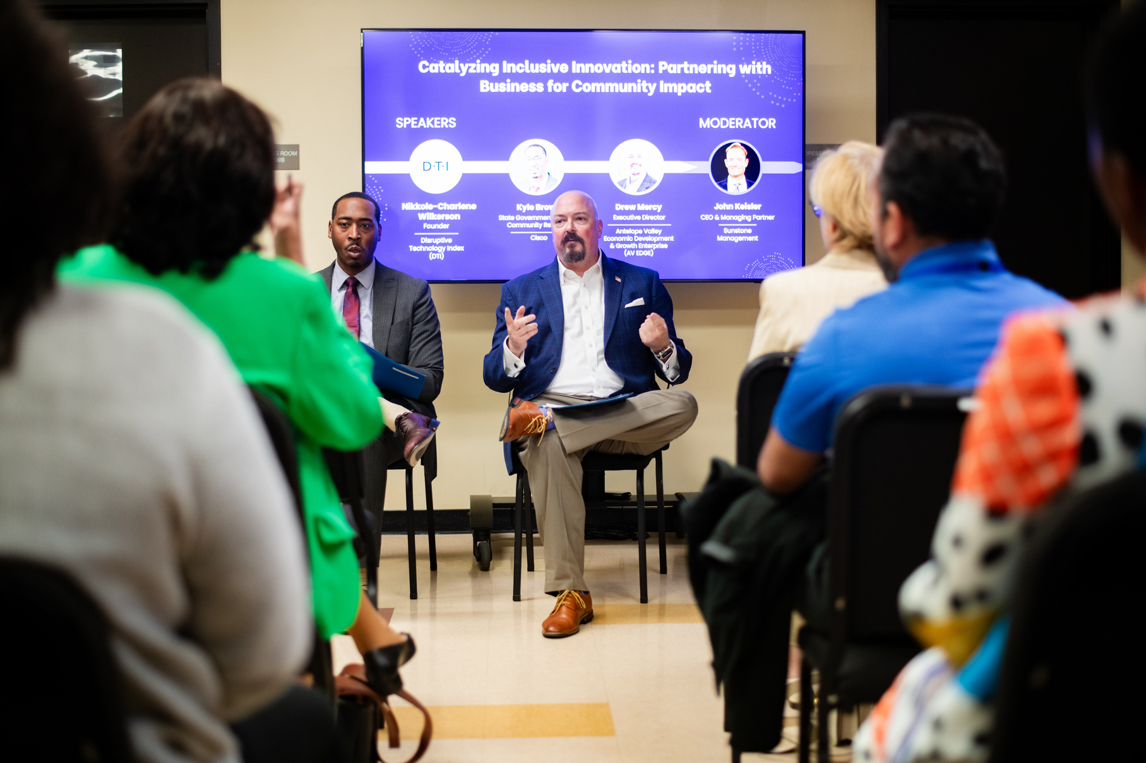
Deliverable: AV EDGE shall attend and represent the cities and region at a minimum of four (4) industrial/real estate conferences/forums per year. AV EDGE will share any materials, contacts, and information learned with city staff.
Status: Q2: 50% of goal. YTD: 75% of goal (as of 3/19/2026)
8. CONFERENCES
(INDUSTRIAL/REAL ESTATE)

Slide 10
Deliverable: AV EDGE will feature the Cities prominently and equally in all marketing collateral. AV EDGE shall provide quarterly documentation highlighting how and where the Cities have been promoted.
Status: Q2: 25% of goal. YTD: 50% of goal.
9. MARKETING &
PUBLICATIONS

Slide 11
Deliverable: Each city shall have a designated seat on the Executive Committee and Board of Directors. Voting rights are not limited to the listed designee, any city staff member may be designated to attend and carry the city’s vote at any meeting.
Status: Q2: 25% of goal. YTD: 50% of goal.
City of Palmdale Designee: Zach Glynn
10. GOVERNANCE
REPRESENTATION

Slide 12

Deliverable: AV EDGE shall compile and publish a Labor Market Study every two years. Last LMS published in Spring 2025. Can be found online at www.avedgeca.org
Status: No activity until Fall 2026.
11. LABOR MARKET
STUDY

Slide 13
Deliverable: Deliverables shall include meeting reports with identified opportunities, recommended action items, and documentation of stakeholder interactions.
Status: Q2: 25% of goal. YTD: 50% of goal.
12. CITY MEETING
PARTICIPATION

Slide 14

Deliverable: AV EDGE shall host two industry specific deep dive roundtables per year to discuss industry needs, identify gaps, develop action items and report back to the cities.
Status: Q2: 0% of goal. YTD: 0% of goal.
13. INDUSTRY
DEEP DIVES

Slide 15
14. REGIONAL FILM INDUSTRY ENGAGEMENT
Deliverable: AV EDGE shall host one film industry roundtable per year to discuss strategies to expand filming in the region, discuss industry needs, identify gaps, develop action items and report back to the cities.
Status: Q2: 0% of goal. YTD: 0% of goal.

Slide 16
Deliverable: AV EDGE shall coordinate efforts with MOU Partners to support and bring awareness to programs offered by organizations, including but not limited to the Small Business Development Center and America’s Job Center of California. AV EDGE shall provide links on their website and develop flyers and information compiling these and similar programs for tech and small business start-ups.
Status: Q2: 25% of goal. YTD: 50% of goal.
15. STARTUP & SMALL BUSINESS SUPPORT

Slide 17

Deliverable: Deliverables shall include a summary of activities, employer feedback, and recommendations to align programs with local workforce needs. Deliverables shall also include summaries of key discussions, space and facility requirements based on feedback.
Status: Q2: 25% of goal. YTD: 50% of goal.
16. WORKFORCE
DEVELOPMENT
ADVOCACY

Slide 18
17. TRANSPORTATION ADVOCACY
Deliverable: Deliverables shall include a summary of advocacy efforts, a list of meetings coordinated, and recommended next steps to keep projects moving forward.
Status: Q2: 25% of goal. YTD: 50% of goal.

Slide 19
Deliverable: AV EDGE shall establish an online community calendar with AI and automatic input functionality to seamlessly incorporate local government, civic organizations and regional events to populate a comprehensive Antelope Valley community Calendar.
Status: Ongoing: Q2: 25% of goal. YTD: 50% of goal. We have connected the City of Palmdale’s RSS to the community calendar. Still working on City of Lancaster but have learned what the hurdles are within local government to ensure the right individuals are brought in to speed things up.
18. COMMUNITY
CALENDAR

Slide 20

Deliverable: AV EDGE shall provide support letters for local government and civic organization grant applications, assess and provide input on state and federal legislation. Support letters requested by the cities shall be provided within three (3) business days.
Status: Ongoing. Q2: 25% of goal. YTD: 50% of goal.
19. ADVOCACY

Slide 21
Roundtable Report and Spring Business Summit moving forward on schedule.
Industry Deep Dives progressing.
Reorganization and Restructuring of Committees has increased participation and coordination on MOU designated projects.
Broker Newsletter published.
SUMMARY/KEY WINS THIS QUARTER

Slide 22
CHALLENGES/NEEDS FROM MOU PARTNERS
Another slow quarter on Item 1, Lead generation, although not unexpexted around the holiday season. February has already started off strong and expect be caught up by end of Q3 with conference schedule.

Slide 23
THANK YOU

