Slide 1


The 2026
Economic Outlook
U.S, California
And the Antelope Valley
March 19, 2026
Mark Schniepp
Director

Slide 2
What you need to Know: U.S Economy
Overall growth in 2025 much better than expected
Tariff hysteria has subsided
The stock market is just off its all time highs
which makes us all feel richer
Labor markets still creating jobs, though barely
and this is a big concern
Interest rates are steadily in decline
3 rate cuts in 2025
What will the Fed do during the rest of this year ?

Slide 3
Quiz 1: What will the FED do ?
They next meet April 28
Nothing . . . . they are done cutting !
One more cut of ¼ point
Two more cuts of ¼ point each
A full 100 basis point cut by the end of the year !
Whatever they do it will probably result in a misstep

Slide 4
6.0 percent

Slide 5
2.4 percent
Fed
Target

Slide 7
Conundrum:
Low job growth but
Low unemployment rate

Slide 9
S&P 500: up 12 % year-to-date
Nasdaq: up 16 % year-to-date
34 / 45

Slide 10

AI and jobs Are we ready for what’s coming ?

Slide 12
The Dubious Issues with AI: Market Disruption
Now in Phase 1: AI performance improvements accelerate
~ enabling meaningful replacement of human workers
Phase 2 is a concern:
~ Displaced human workers stop buying stuff
Phase 3 is a bigger concern:
~ Sales drop, more layoffs, firms reduce prices to increase sales
Company earnings decline, stock market devalues
Growth from AI productivity offset by spending pullback

Slide 13
ChatGPT
Debuts
11-30-22

Slide 14
The Hopeful Issues with AI: Growth w/o Trauma
Phase 1: Widespread adoption of AI
~ not much new job creation, but not many layoffs either
Phase 2:
~ Not much displacement; HHs continue to spend
Phase 4: AI maintenance and expansion
~ demand for AI workers to manage, update, implement
No doomsday scenario for workers
Growth from AI productivity offset by spending pullback

Slide 15
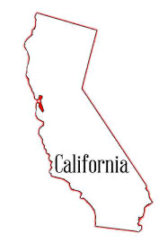
California Issues in 2025
New Development has typically been a principal engine of growth for the economy especially since the pandemic
However “No viable path” to completing the HSR says U.S. DOT
So $4 billion in funding was cancelled in July
We are in a housing crisis but there is less new housing this year . . . .
Venture Capital AI funding at record levels
Labor markets appear troublesome for first time in 15 years

Slide 16
SB 9 4 units on a lot
SB 10 upzone housing areas
SB 35 ministerial approval of housing
AB 2011 enables apts on commercial lots
SB 1211 enables more ADUs on a lot

Slide 17
Recent Evidence: California Labor Market
Feeble
Unemployment rate rising . . . now at 5.5 percent
--- highest among all states
Pace of job creation this year: 65,000 jobs
--- The 2015 to 2019 pace was 371,000 per month
Not broad based: only 2 sectors creating jobs
Employment contracting in manufacturing, technology sectors, financial activities, film, TV & sound recording
Layoffs escalating, . . . . why ?

Slide 18
last 35 months:
+ 7,000 jobs / month

Slide 20
pandemic
16 to 19: 21.9 % and rising
20 to 24: 9.9 % and rising
25 to 44: 4.8 %, not rising
45 to 65: 3.5 %, stable

Slide 22
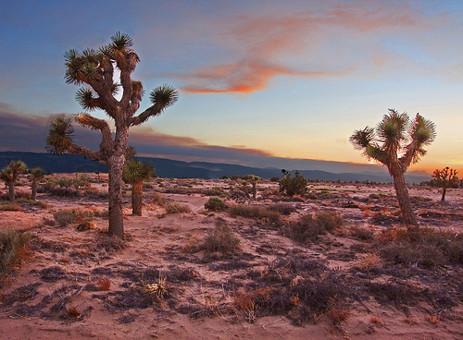
Antelope Valley

Slide 23
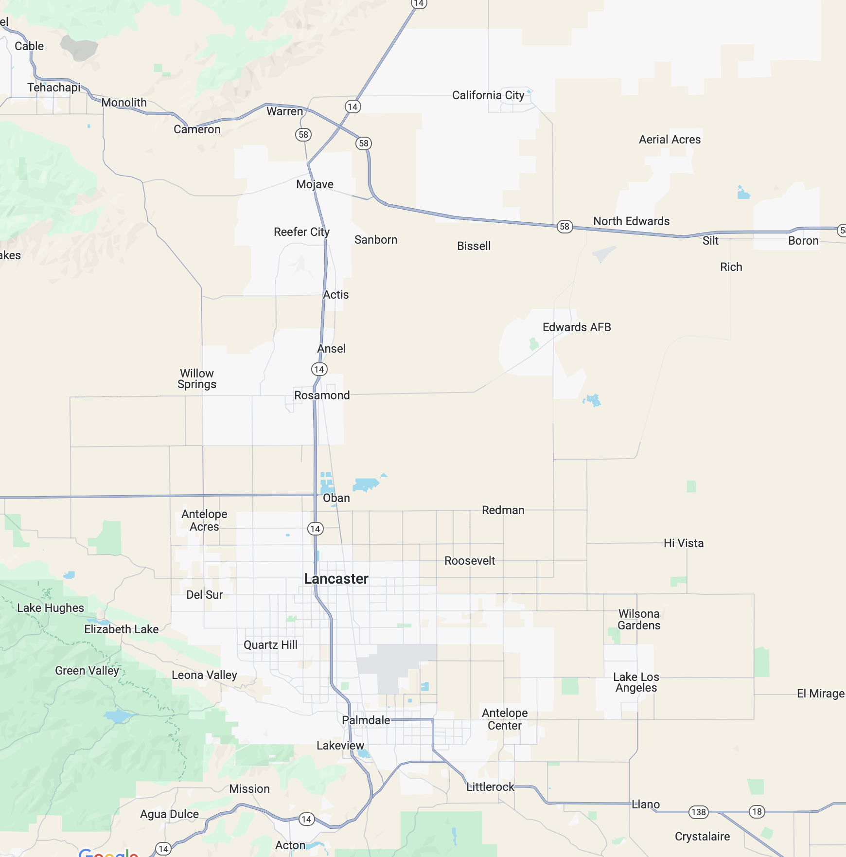

Slide 24
The Antelope Valley / 2026
Population: 484,786
LA County: 409,965
Southeastern Kern: 81,496
Greater Ridgecrest: 35,900
Unemployment Rate (January 2026):
AV -- LA County 6.4 percent
AV – Kern Counrty 15.1 percent
Employed residents: 192,900
W-2 Jobs in the region: 108,250

Slide 25
Recent Evidence Antelope Valley
Population growth has turned around
Job formation in the labor markets is weak (like everywhere else)
However, unemployment rate is steady and relatively low
The widespread adoption of AI systems in California is also impacting the tech sectors here, but not mfg
New residential development is accelerating
New industrial development is prolific
Tariff policies have not impacted the region much, like the rest of the state

Slide 27
Tehachapi
Mojave
California City
Boron
Rosamond

Slide 32
New Development Summary / Palmdale
Residential Apartments |  | Residential Single Family Units | Industrial (square feet)
Under Construction | 101 | 0 | 130,000
Approved | 584 | 239 | 16,287,000
Pending | 257 | 1,191 | 683,000
Total | 942 | 1,430 | 17,100,000

Slide 33
New Development Summary / Lancaster
Residential Apartments |  | Residential Single Family Units | Industrial (square feet)
Under Construction | 919 | 557 | 490,000
Approved | 228 | 0 | 2,070,000
Pending | 0 | 0 | 5,716,144
Total | 1,147 | 557 | 8,276,144

Slide 34
New Development
Kern County
Tehachapi Commercial & Residential Projects underway
New Gas Station, mini-mart, retail space
RV park and storage facility
Condominium development
Aspen Marketplace – commercial retail center
Tehachapi Sage Ranch – 1000 units underway
Willow Rock Energy Storage Center pre-construction
Mojave Steel Mill and Solar Project underway
Rosamond South Solar Project completed 11/25
Golden City Plaza commercial development underway
Cerro Coso Community College Expansion underway

Slide 35
New Development
Palmdale
Legacy at Palmdale – 99,000 SF warehouse completed
AS Aerospace Manufacturing Facility – 90,000 SF underway
Maison’s Village Phase II – 191 Housing units underway
Ritter Ranch – 600 units underway
Quail Valley – 730 single family residences pending
The Hub industrial buildings 1.4 mil SF approved
Falcon Glen – 394 single family residences pending
Forever Link – industrial buildings totaling 200,000 SF approved
Hilton Towne Place Suites under construction
Extended Stay America under construction
Anaverde Nuevo Development - 700 units active expansion of project

Slide 36
New Development
Lancaster
Northpoint II Development – totaling 490,000 SF under construction
Desert Meadows – 420 residential units under construction
Sierra Azul Apartments – 228 residential units approved
Antelope Valley Commerce Center – 8.6 mil SF approved
Seefried Industrial Project – 1.2 mil SF approved
Element Hydrogen Project approved
Parkway Village Specific Plan approved
Mosaic High Rise – retirement community 146 units to start in spring
Westside Annexation approved pending lawsuit
~ 39 million SF commercial/industrial

Slide 37

The 2026 Forecast

Slide 38
The 2026 Forecast
Q2 and Q3 growth were exceptional and strong expectations for Q4 were derailed by the 43 day gov’t shutdown
Faster growth in 2026, GDP, not employment
Double fiscal stimulus this year (maybe triple)
Tax cuts
Tax refunds
Tariff refunds
AI adoption continues to broaden. Consequently, the labor market is threatened if new jobs created by AI don’t offset jobs AI replaces
Inflation gradually moves towards Fed target toward end of 2026
Housing market improves gradually throughout 2026
Price appreciation will be limited

Slide 39
The 2026 Forecast
Inflation gradually moves towards Fed target toward end of 2026
Housing market improves gradually throughout 2026
Price appreciation will be limited

Slide 41
UCLA Anderson
Forecast

Slide 43
a
expansion
F
a
F
a
v≈
≈
F
F
F

