Slide 1

AVEDGE 2026
COMMERCIAL REAL ESTATE
MARKET UPDATE

Slide 2






update
HOUSING: THE ENGINE BEHIND COMMERCIAL
A STRATEGIC MARKET IN A DISCIPLINED CYCLE
THE FRENZY IS OVER. FUNDAMENTALS REMAIN
INDUSTRIAL IS STILL THE ENGINE
RETAIL WORKS
LAND IS THE LONG-TERM ADVANTAGE
DISCIPLINE IS DRIVING DECISIONS
RISK HAS SHIFTED — NOT DISAPPEARED
Seffi Toneman
Broker-Owner
661-600-1269 Office
661-609-0860 Cell
Seffi@CommercialBrokersGroupInc.com
www.CommercialBrokersGroupInc.com
@CommercialBrokersGroup

Slide 3

What the Housing Market Is Telling Us About the Economy
2021
2022
2023
2024
2025
AV
HOME SALES
5,958
4,738
3,670
3,382
3,135
MORTGAGE
RATES
DOUBLED
2021
TODAY
~3%
~6.5-7%

Slide 4
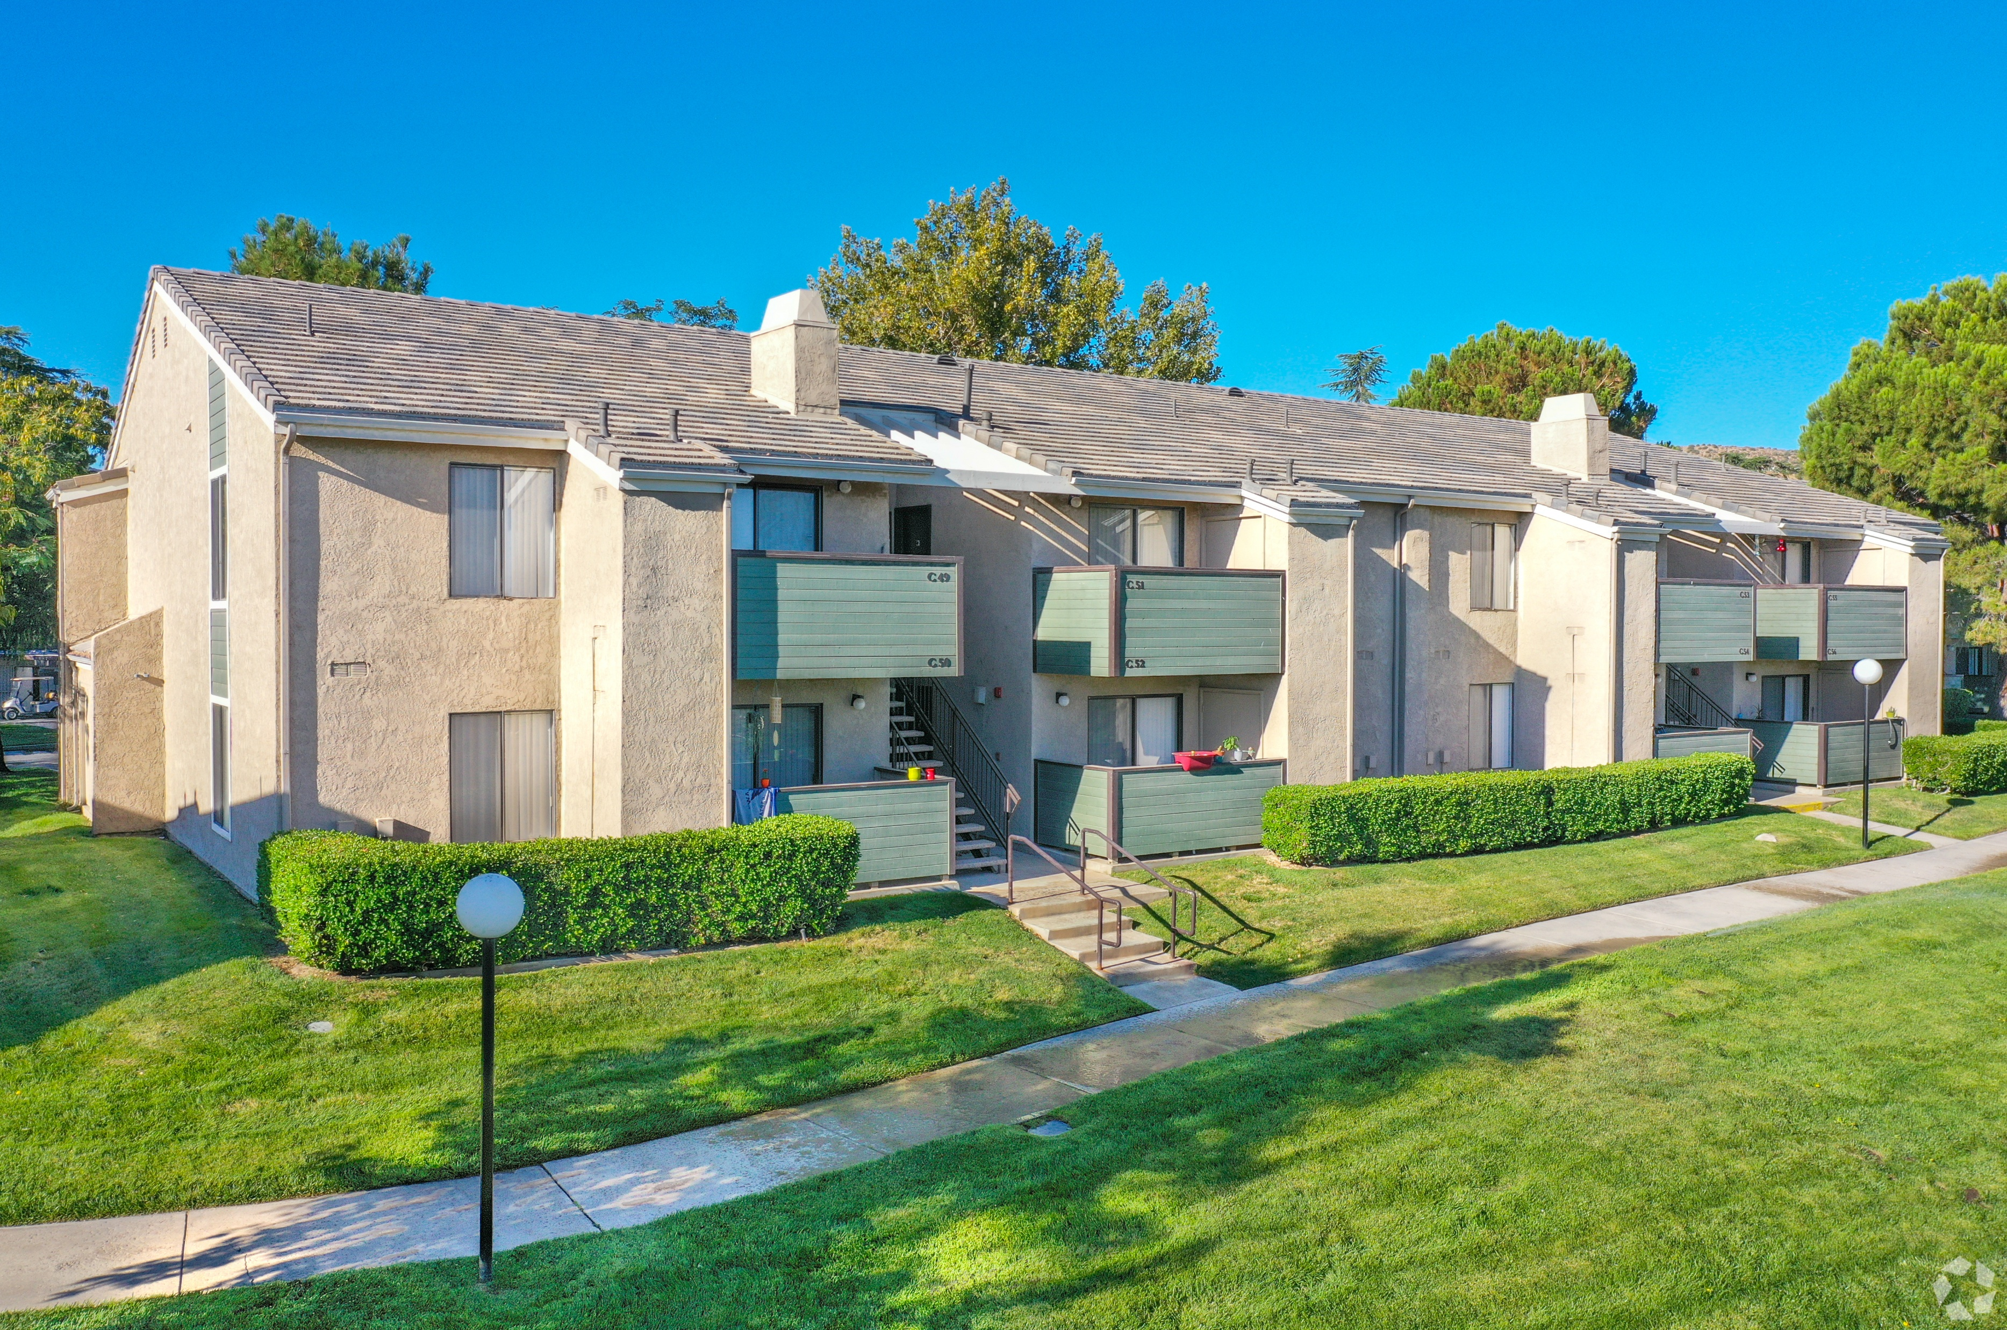
DARE TO COMPARE
ANTELOPE VALLEY
SANTA CLARITA
200
$175
$465M
2.3M
6.8%
8.5
75
$300
$364M
1.4M
7.7%
8.6
# OF SALES
PRICE/SF
VOLUME
TOTAL SF
CAP RATE
MONTHS TO SALE

Slide 5
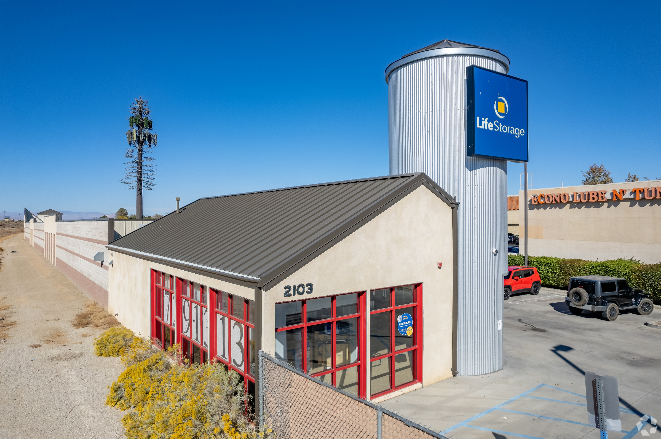
A STRATEGIC MARKET IN A DISCIPLINED CYCLE
Disciplined decision making
• Capital is more selective & underwriting is tighter
• Healthy cycles reward patience, strong assets, and long-term thinking

Slide 6
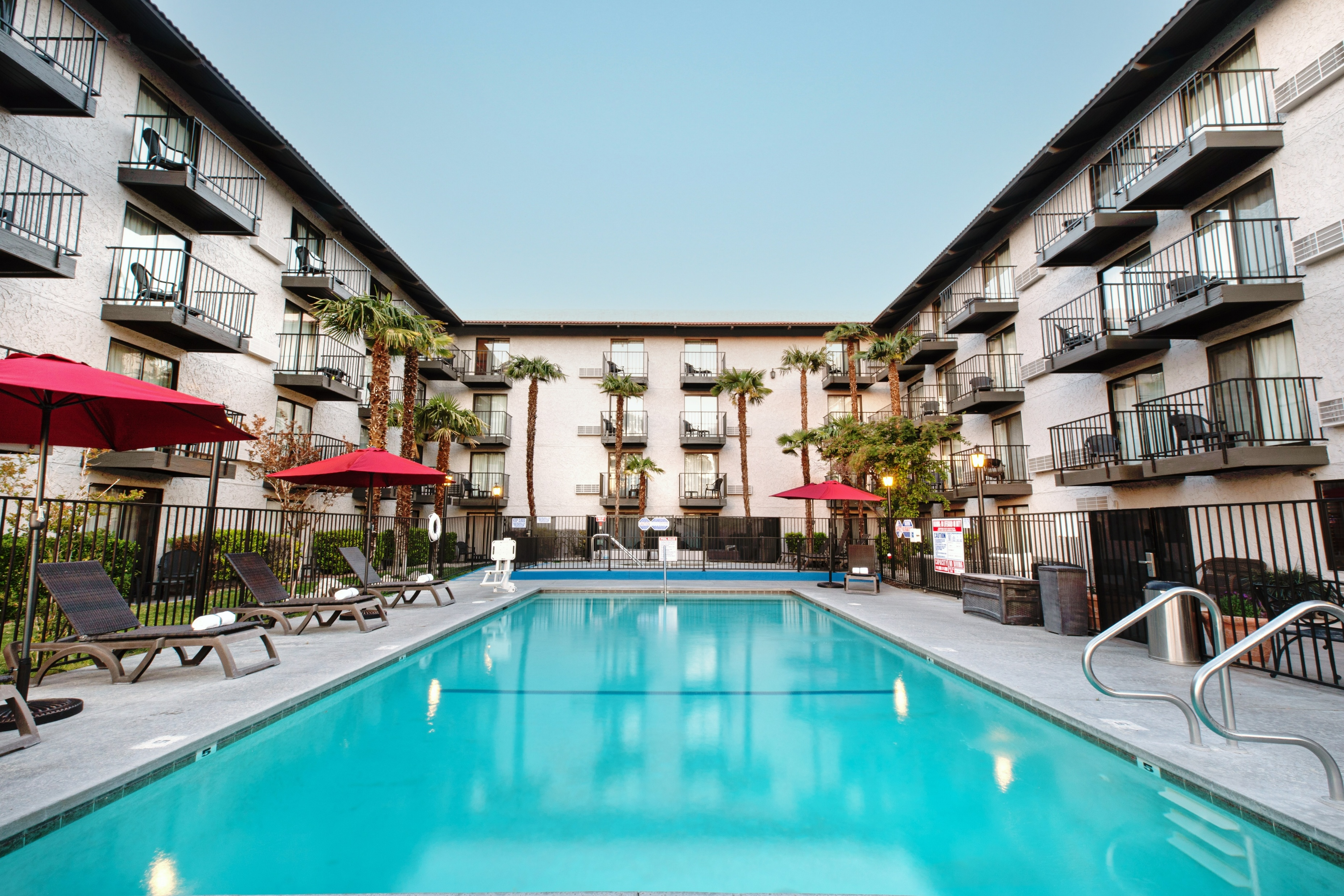
THE FRENZY IS OVER. FUNDAMENTALS REMAIN
• The era of ultra-cheap capital accelerated deal activity
• Today’s market is stabilizing around real fundamentals
• Population growth, logistics access, and land availability still drive demand

Slide 7
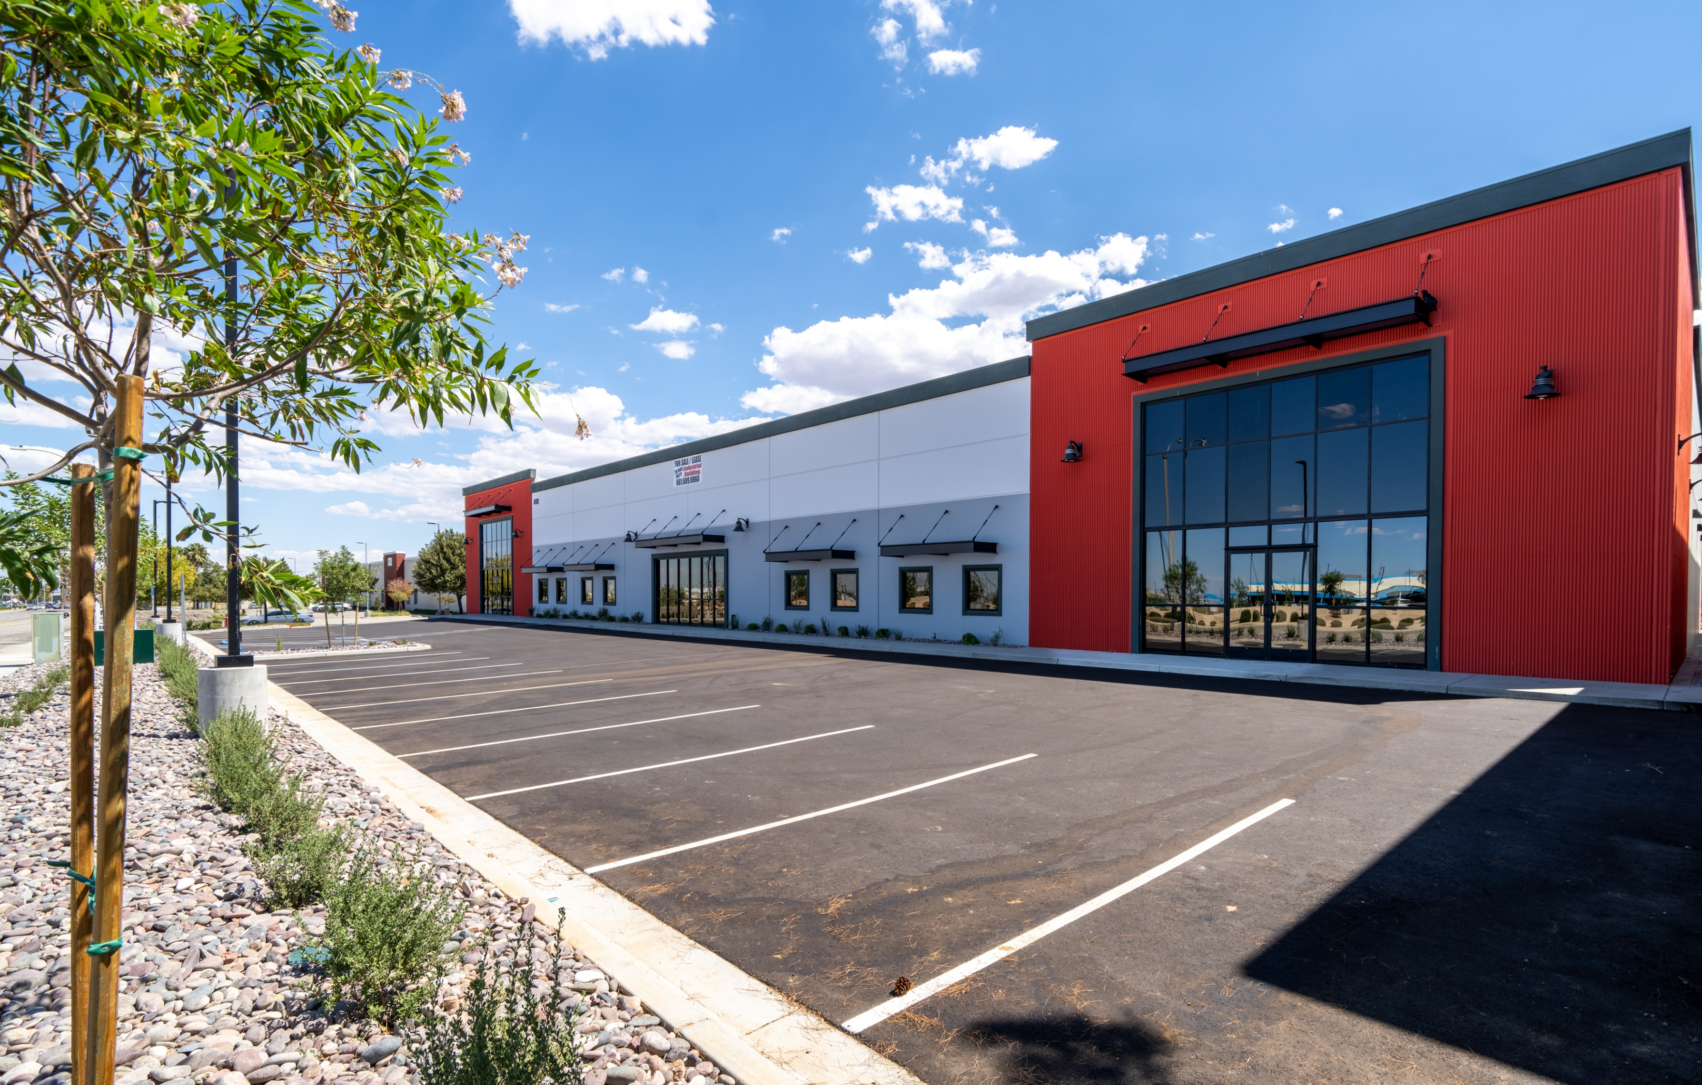
INDUSTRIAL IS STILL THE ENGINE
• Industrial demand continues across Southern California
• Companies don’t choose locations based on headlines
• Distribution, manufacturing, and logistics remain long-term decisions

Slide 8
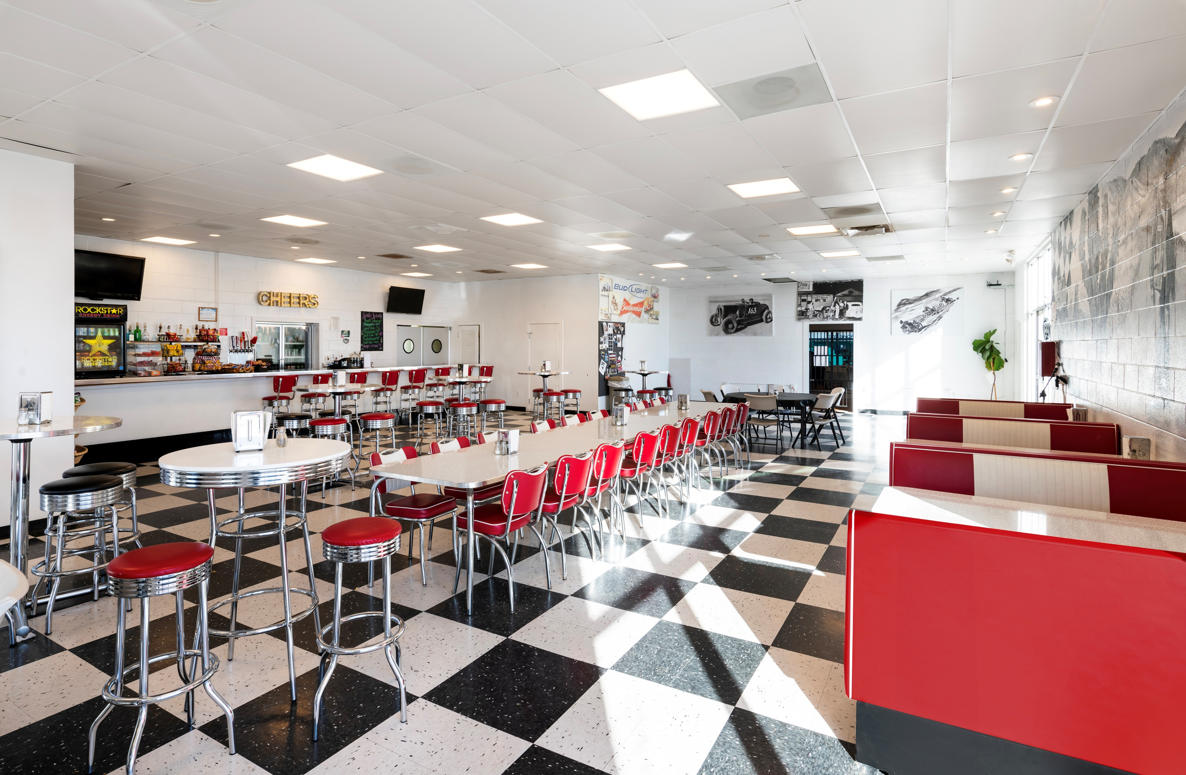
RETAIL WORKS
• Retail now follows household density, not traffic counts
• Service retail continues to perform strongly
• Restaurants, healthcare, and daily-needs retail lead growth

Slide 9

LAND IS THE LONG-TERM ADVANTAGE
• Development capacity in Southern California is extremely limited
• Antelope Valley still offers land for future growth
• Long-term investors focus on markets with expansion capacity

Slide 10
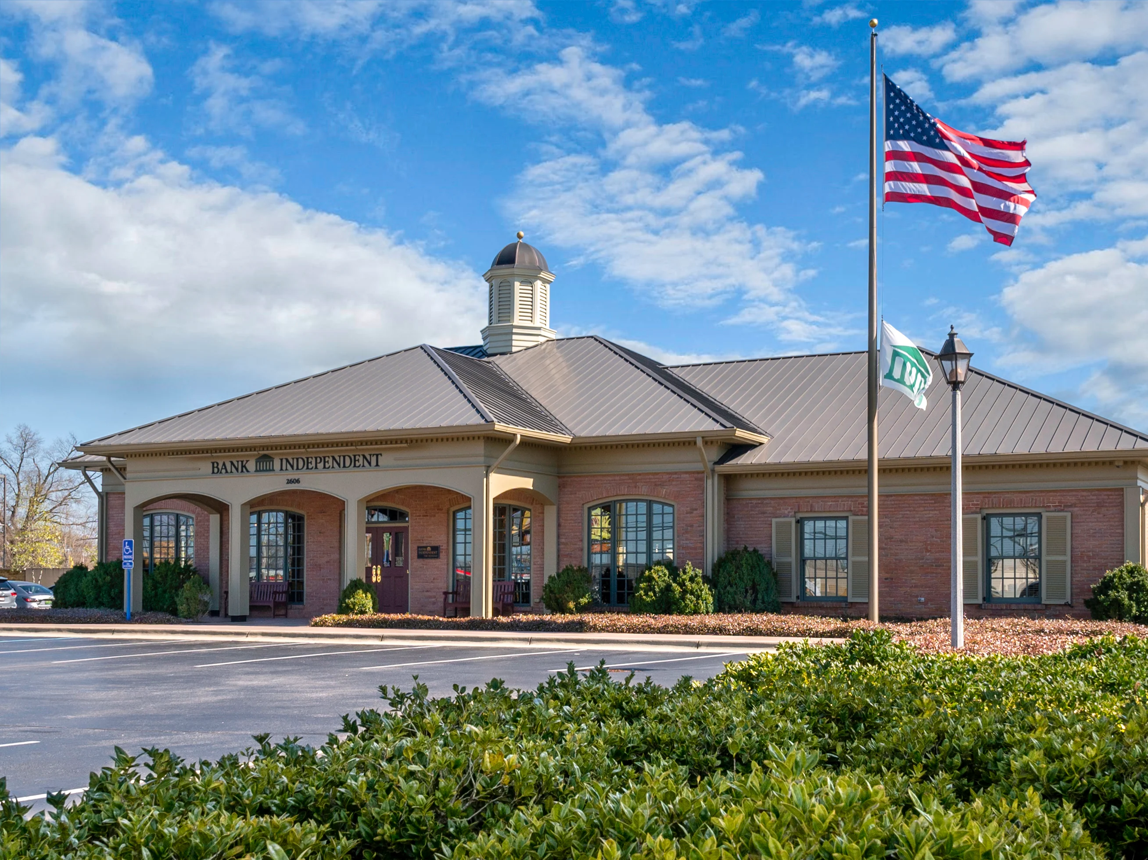
DISCIPLINE IS DRIVING DECISIONS
• Lenders are more cautious
• Investors are underwriting more carefully
• Tenants are planning expansion more strategically

Slide 11
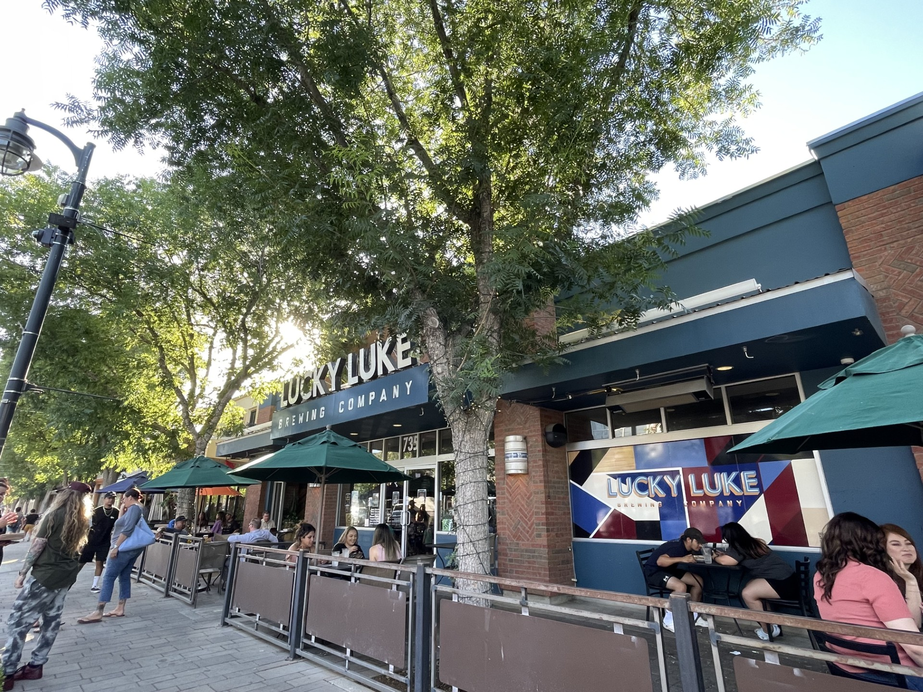
RISK HAS SHIFTED — NOT DISAPPEARED
• Higher interest rates have reset pricing expectations
• Financing timelines are longer and more structured
• Returns are being evaluated more carefully

Slide 12
WHAT SMART PLAYERS ARE DOING NOW
BUYERS:
Be patient but be ready
SELLERS:
Price for today’s market
TENANTS:
Negotiate strategically
LANDLORDS:
Retention is the strategy

Slide 13

WANT TO KNOW MORE?
Seffi Toneman
Commercial Brokers Group
Broker-Owner
O. 661-600-1269
C. 661-609-0860
Seffi@CommercialBrokersGroupInc.com
www. CommercialBrokersGroupInc.com
@CommercialBrokersGroup

