Slide 1
AV EDGE 2025
COMMERCIAL REAL ESTATE
MARKET UPDATE

Slide 2
agenda
2024 IN REVIEW
CURRENT MARKET INSIGHTS
WHAT TO WATCH IN 2025
WHAT TO DO IN 2025
DARE TO COMPARE
1
2
3
4
5
Seffi Toneman
Commercial Brokers Group
Broker-Owner
@CommercialBrokersGroup
661-600-1269 Office
661-609-0860 Cell
Seffi@CommercialBrokersGroupInc.com
www.CommercialBrokersGroupInc.com

Slide 3
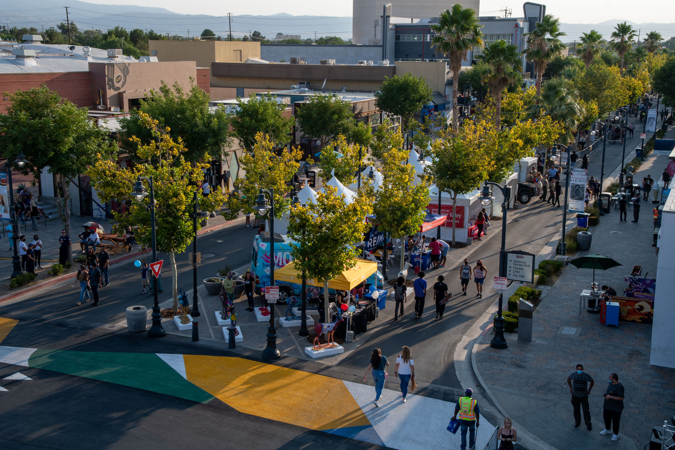
2024 YEAR IN REVIEW | SALES
# OF SALES 219
PRICE/SF $158
VOLUME $317M
TOTAL SF 1.4M
CAP RATE 6.3%
MONTHS TO SALE 12.0

Slide 4
HISTORICAL SALES TRENDS
2020
2021
2022
2023
2024
# OF SALES
PRICE/SF
VOLUME
TOTAL SF
CAP RATE
MONTHS TO SALE
231
$121
$634m
5m
6.9%
13.7
323
$67
$638m
9.6m
6.6%
14.7
374
$134
$985m
5.5m
5.8%
14.2
205
$172
$343m
1.8m
6.2%
11.7
219
$158
$317m
1.4m
6.3%
12.0

Slide 5
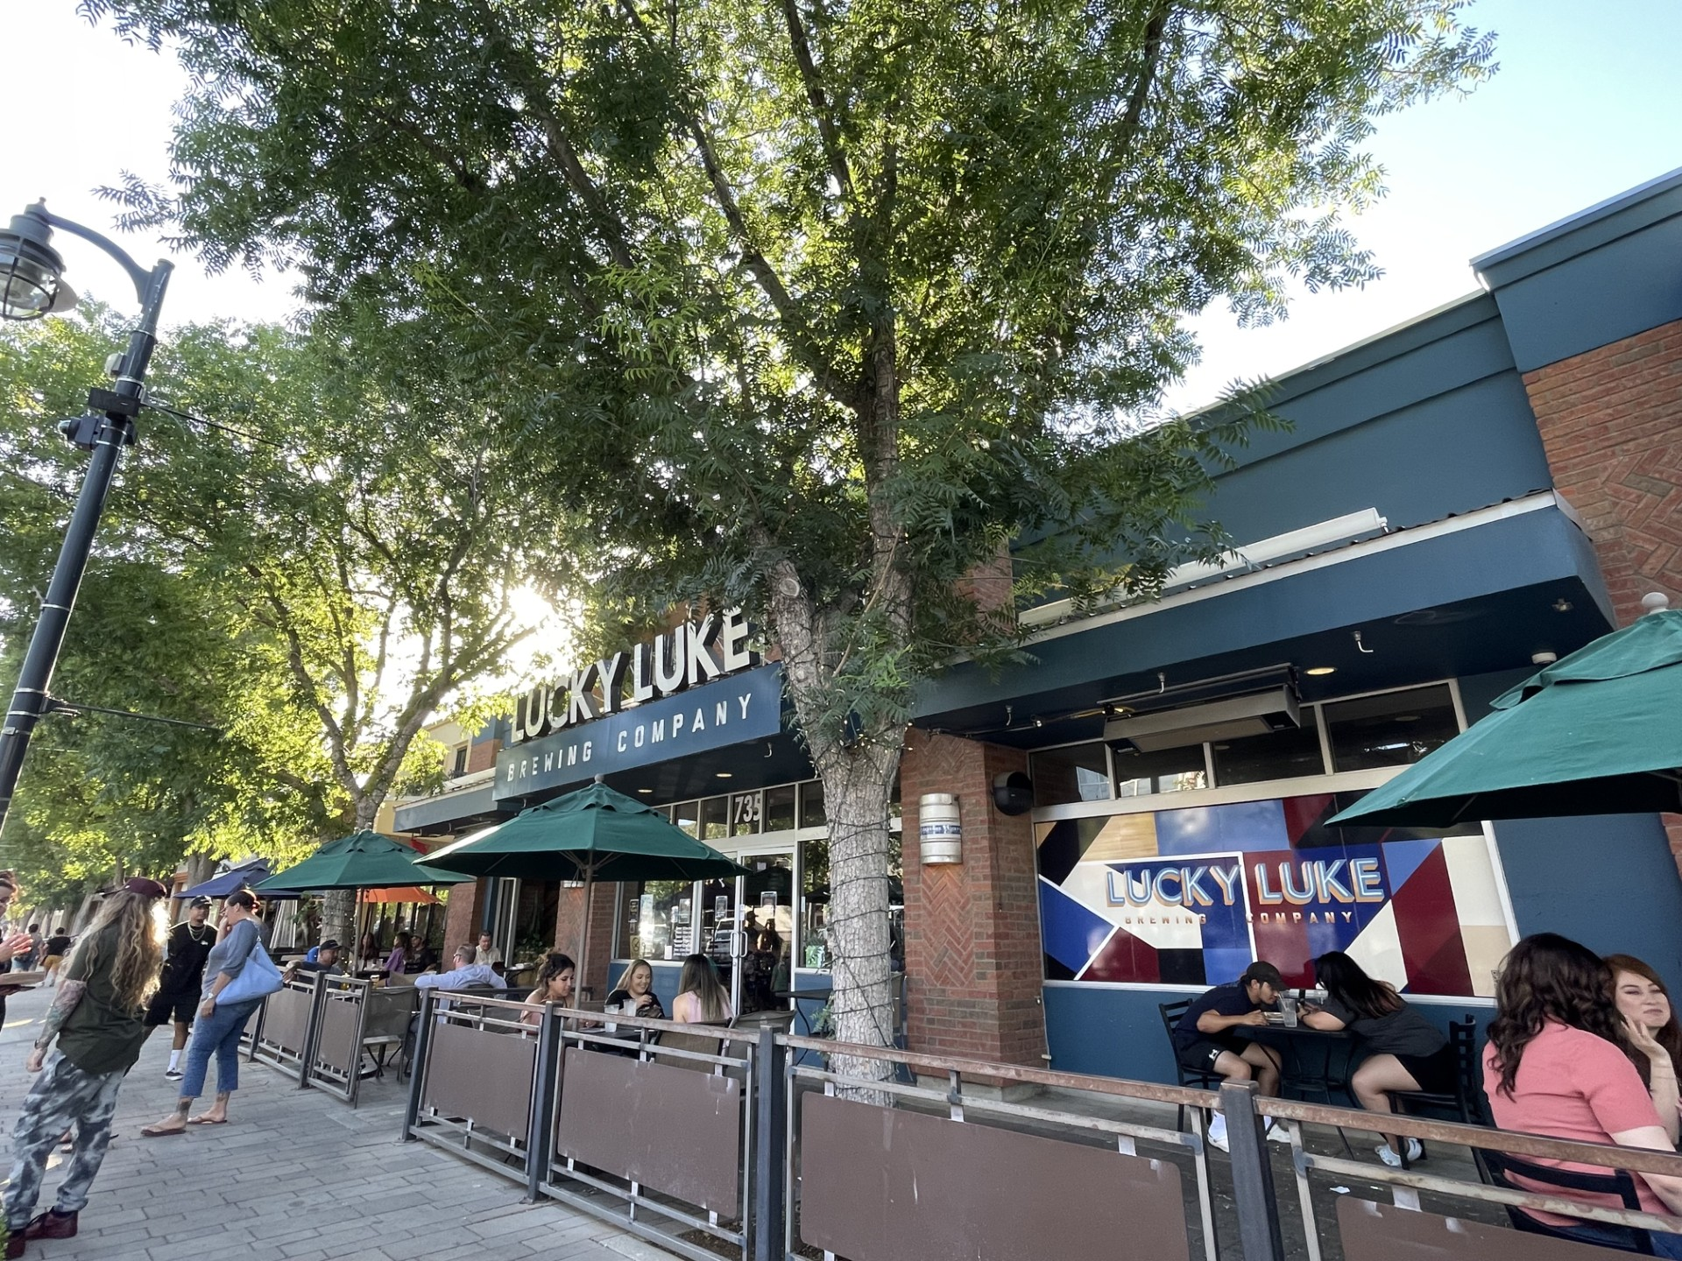
2024 YEAR IN REVIEW | LEASE
# OF LEASES 198
PRICE/SF
INDUSTRIAL $0.98/SF
OFFICE/MEDICAL $1.70/SF
RETAIL $1.70/SF
TOTAL SF 702K
AVG. SIZE 3,546
MONTHS TO LEASE 5.5

Slide 6
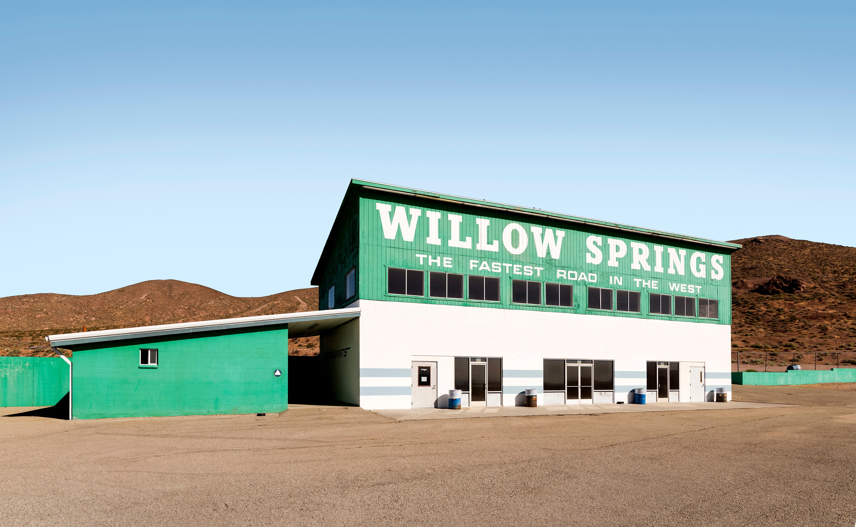
NOTABLE TRANSACTIONS
Historic Willow Springs Raceway
in escrow to private equity firm
Amazon buys 72 acres directly north of
AV Fairgrounds at the 14 freeway
for $26M. Site was entitled for up to 1.2M SF of industrial distribution space
Dollar Tree leases over 53,000SF across AV

Slide 7
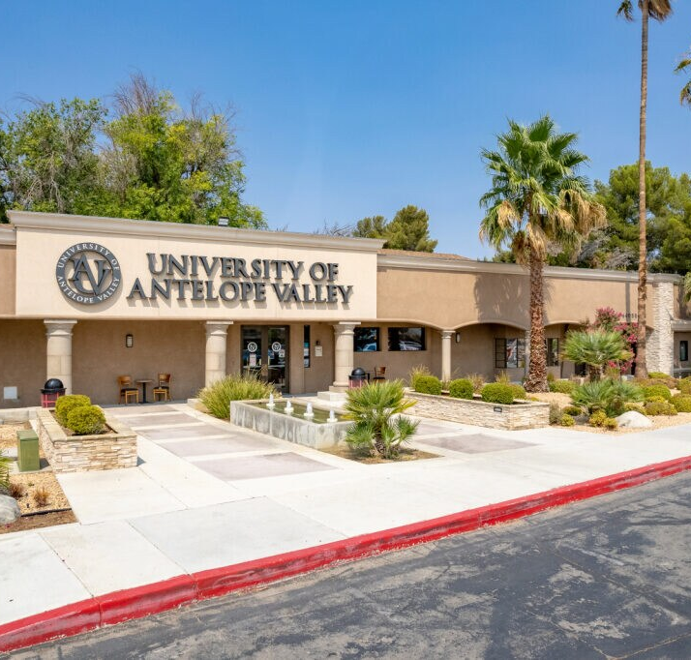
2025 | FOR SALE
TOTAL PROPERTIES: 772
VACANT LAND: 610 parcels avg $3/SF
$80M BUILD TO SUIT
FULLY ENTITLED
DISTRIBUTION WAREHOUSE AT
AVE. G AND 14 FWY
IMPROVED: 162 buildings avg $158/SF
FORMER UNIVERSITY OF ANTELOPE
VALLEY CAMPUS FOR SALE AT
$14M (IN ESCROW)

Slide 8
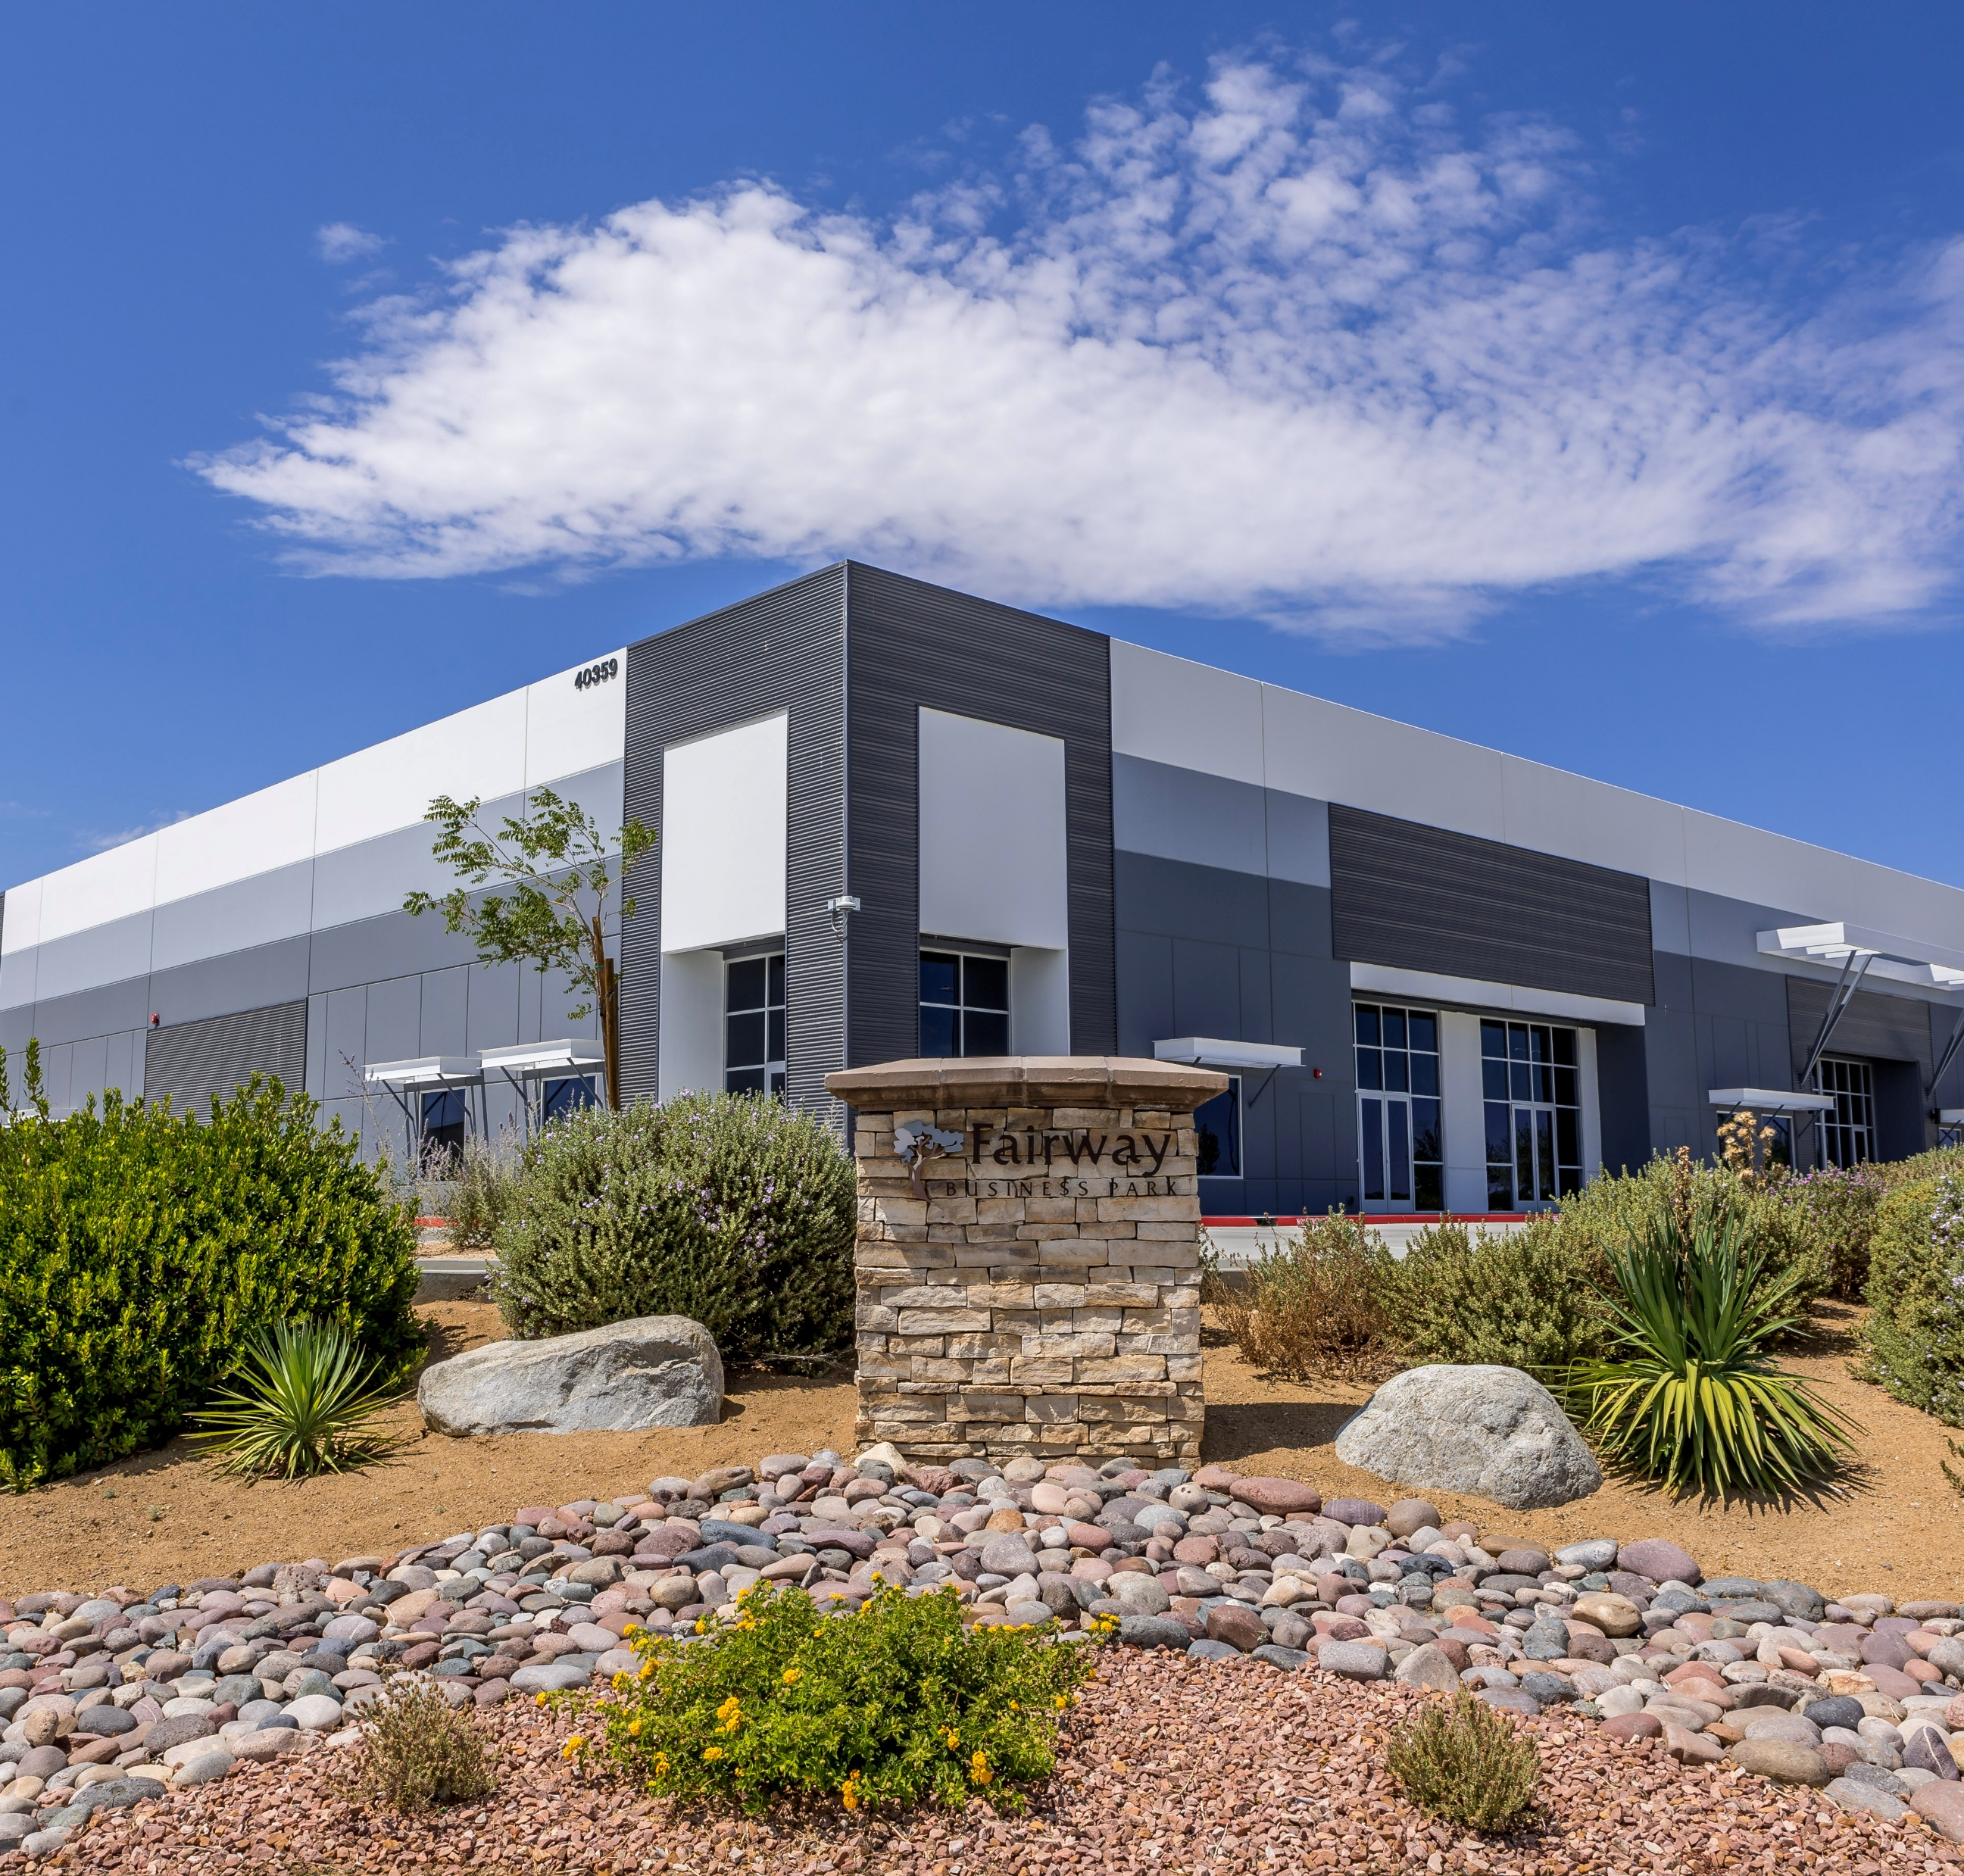
2025 | FOR LEASE
TOTAL PROPERTIES: 247
IMPROVED: 186
1.9M SF AVAILABLE
$2.07/SF AVERAGE RATE
33% VACANCY RATE
12% NET ABSORBTION
PROPOSED : 61 totaling 11.8M SF
32 INDUSTRIAL
29 RETAIL/OFFICE/MEDICAL

Slide 9
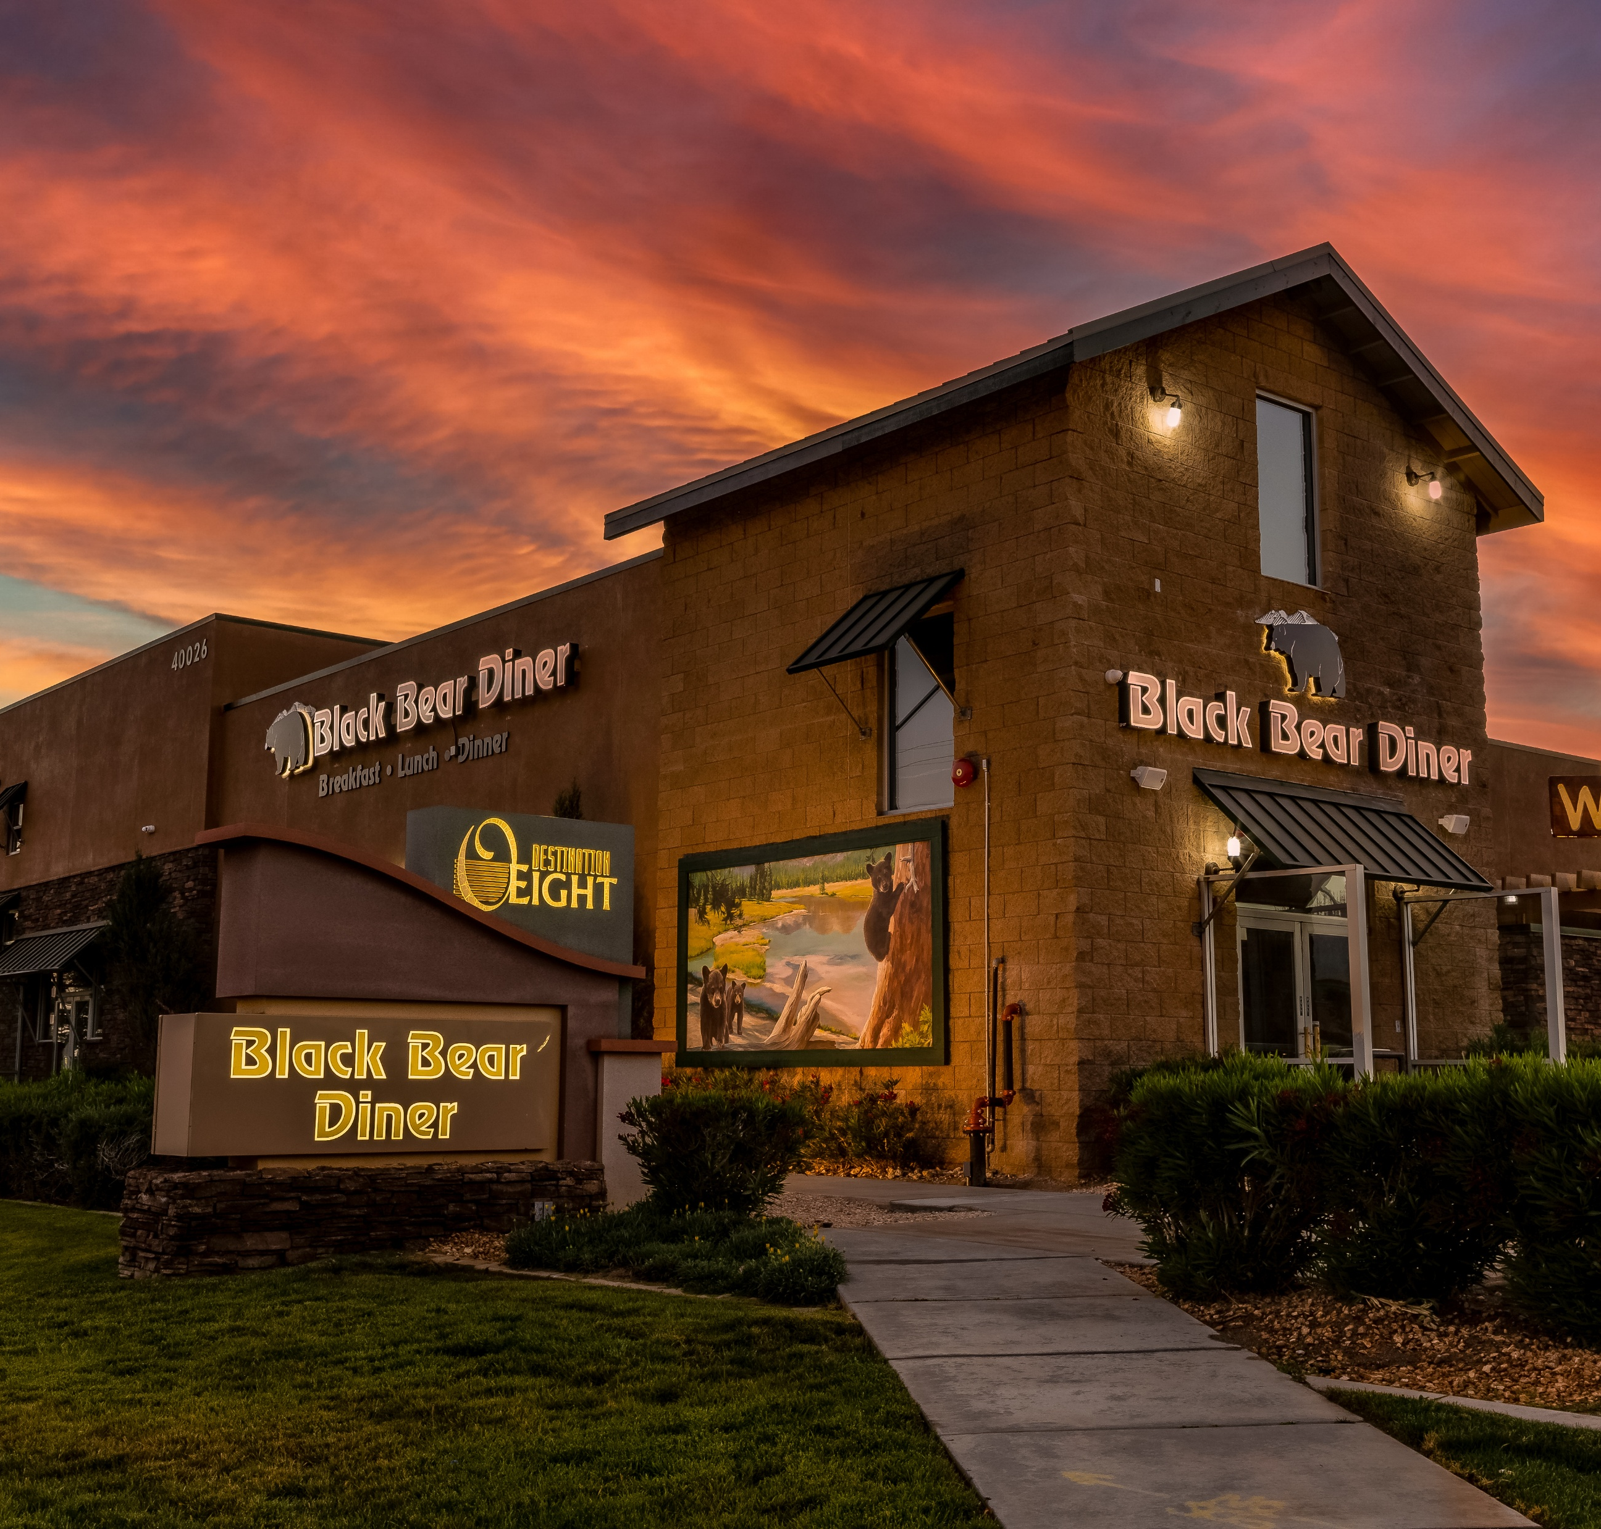
WHAT TO WATCH
11.25% SALES TAX
Starting April 1
1
Return to office
Leasing & Repurposing
2
3
New cre cycle
Investors & Businesses focusing on Stability
e-Commerce & Retail Consolidation
4
INTEREST RATES
Owner Occupied/Investor 7.00-7.50%
SBA 7(a) 8.25-10.25%
SBA 504 1st TD 7.25-7.50%
2nd TD 6.28%
*Mission Bank &
Citizens Business Bank

Slide 10
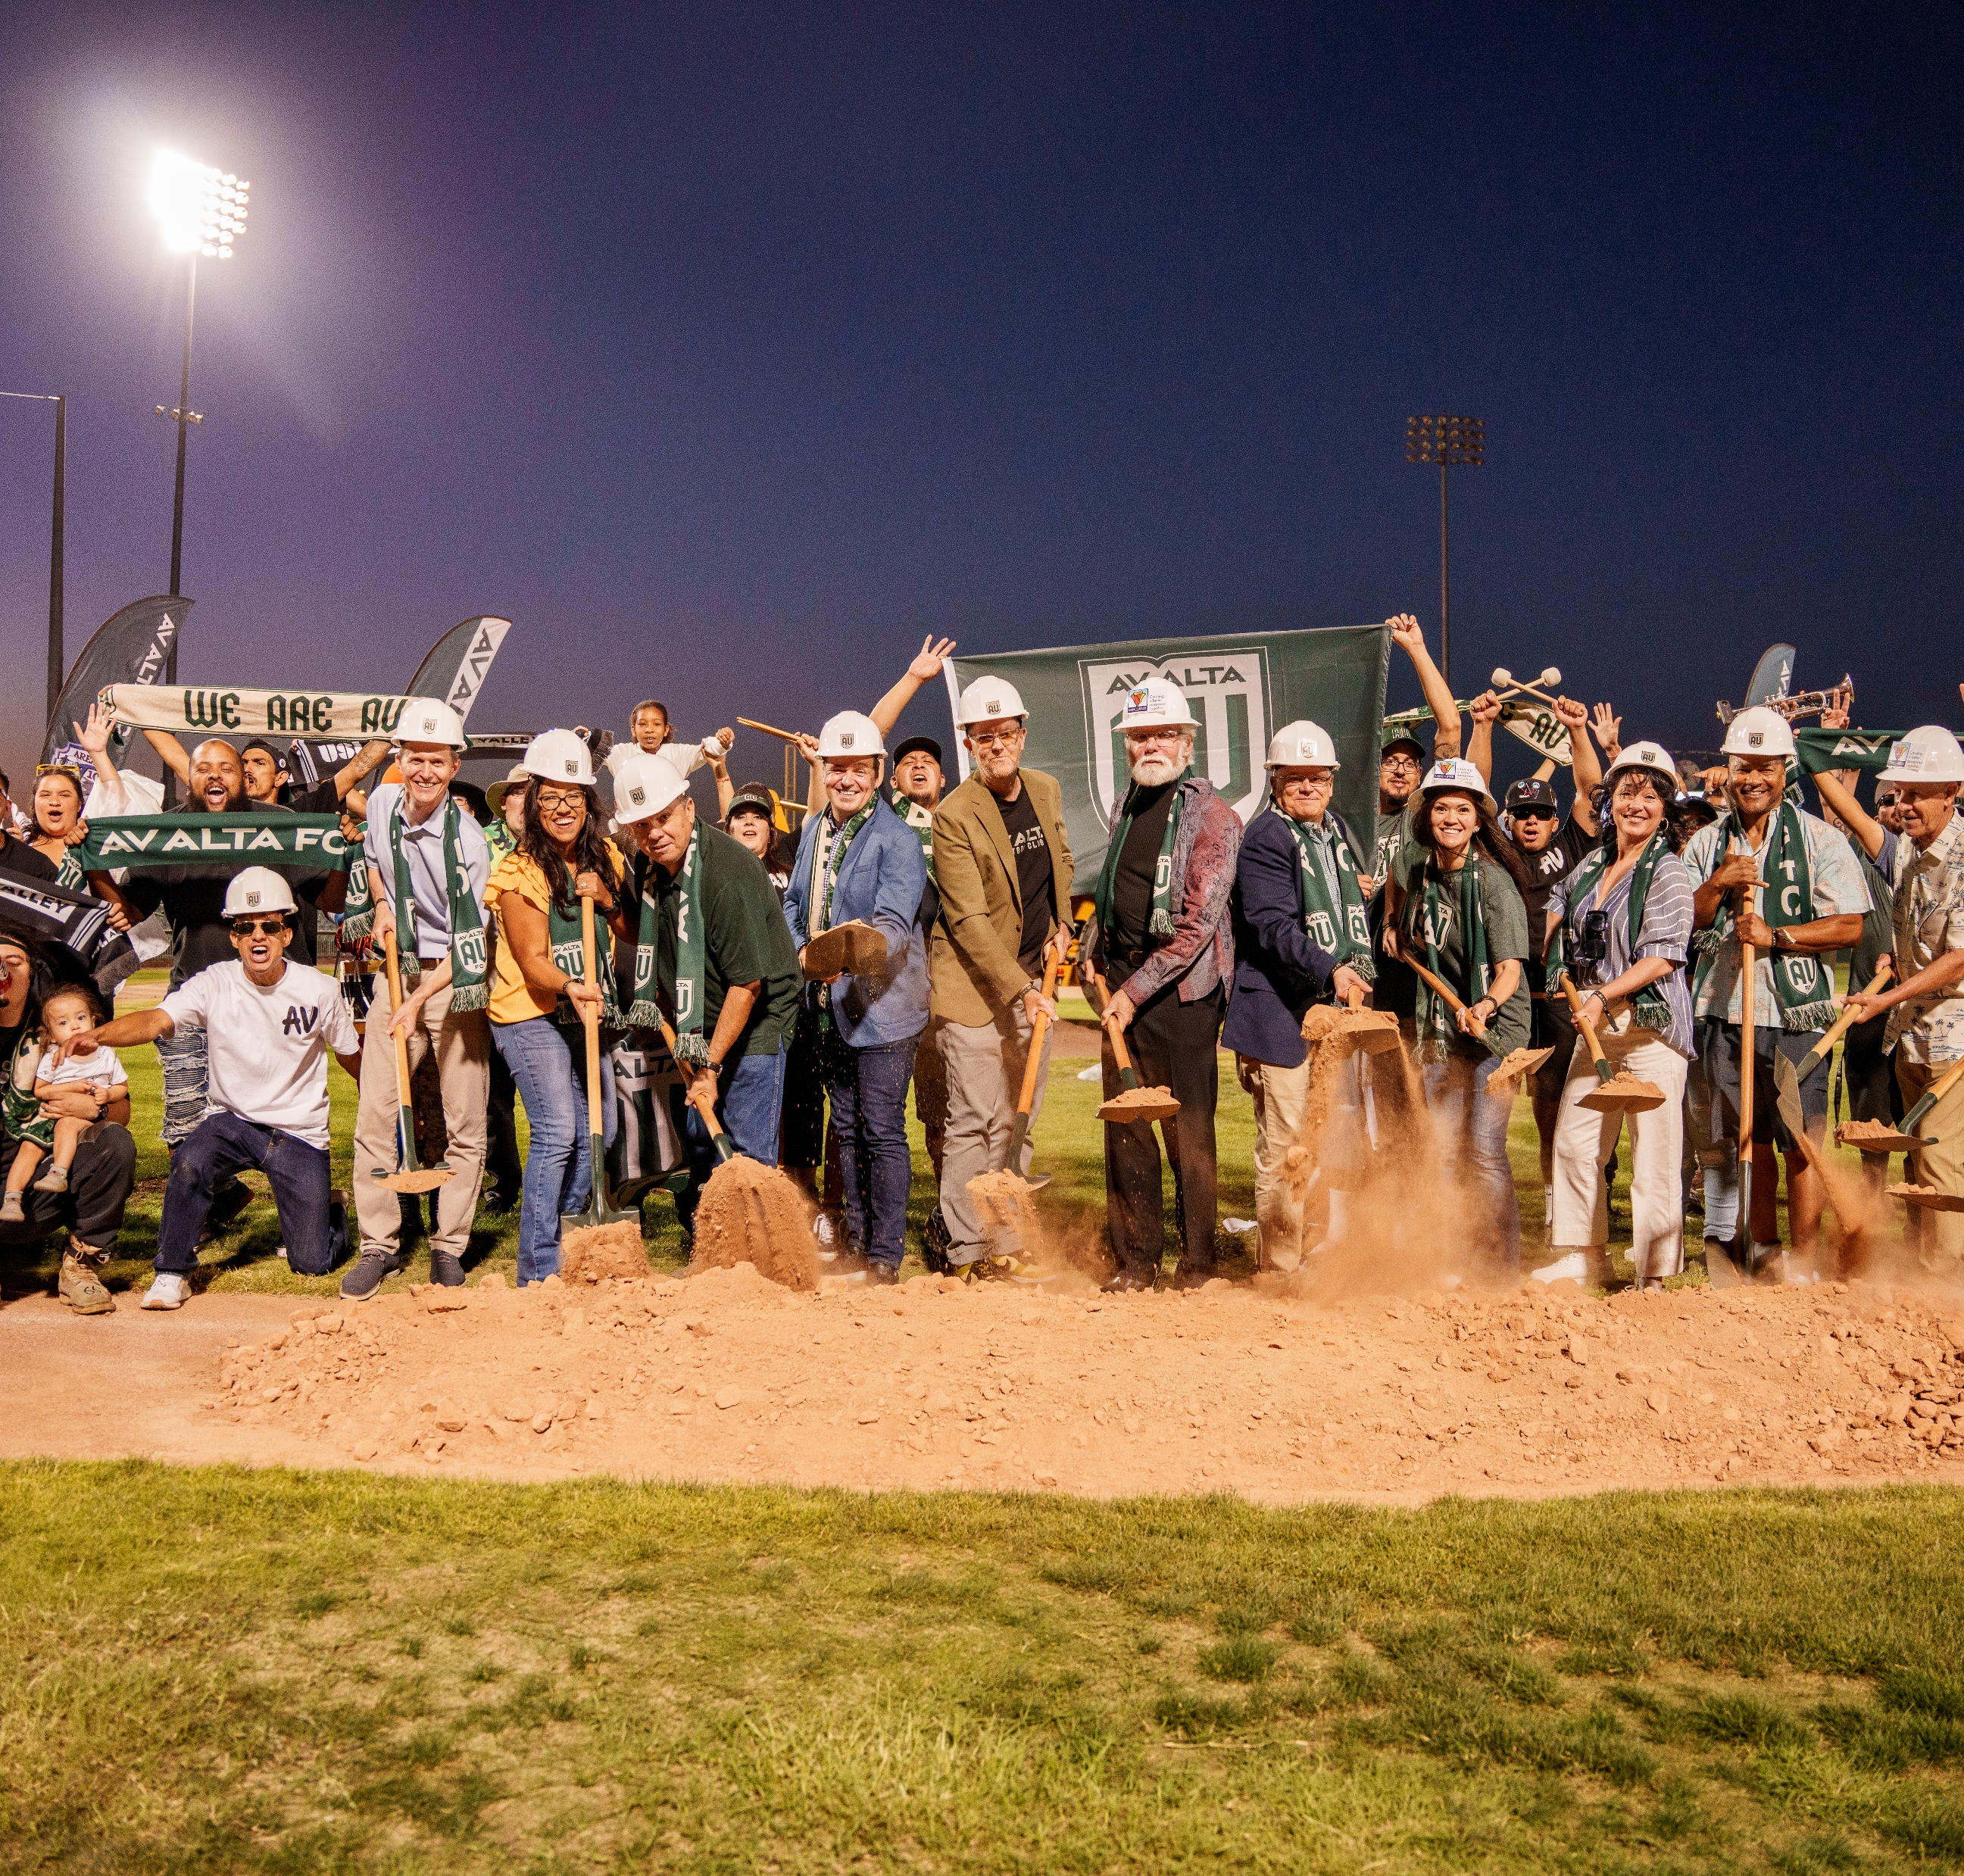
WHAT TO DO
BUYERS & SELLERS
Negotiate Seller Financing
Private/Public Partnerships
Plan Ahead
Fundamentals
Tenants & landlords
Return to longer term leases
Tenants holding more negotiating power
Repurposing & Mixed Uses
Strong lease rates

Slide 11
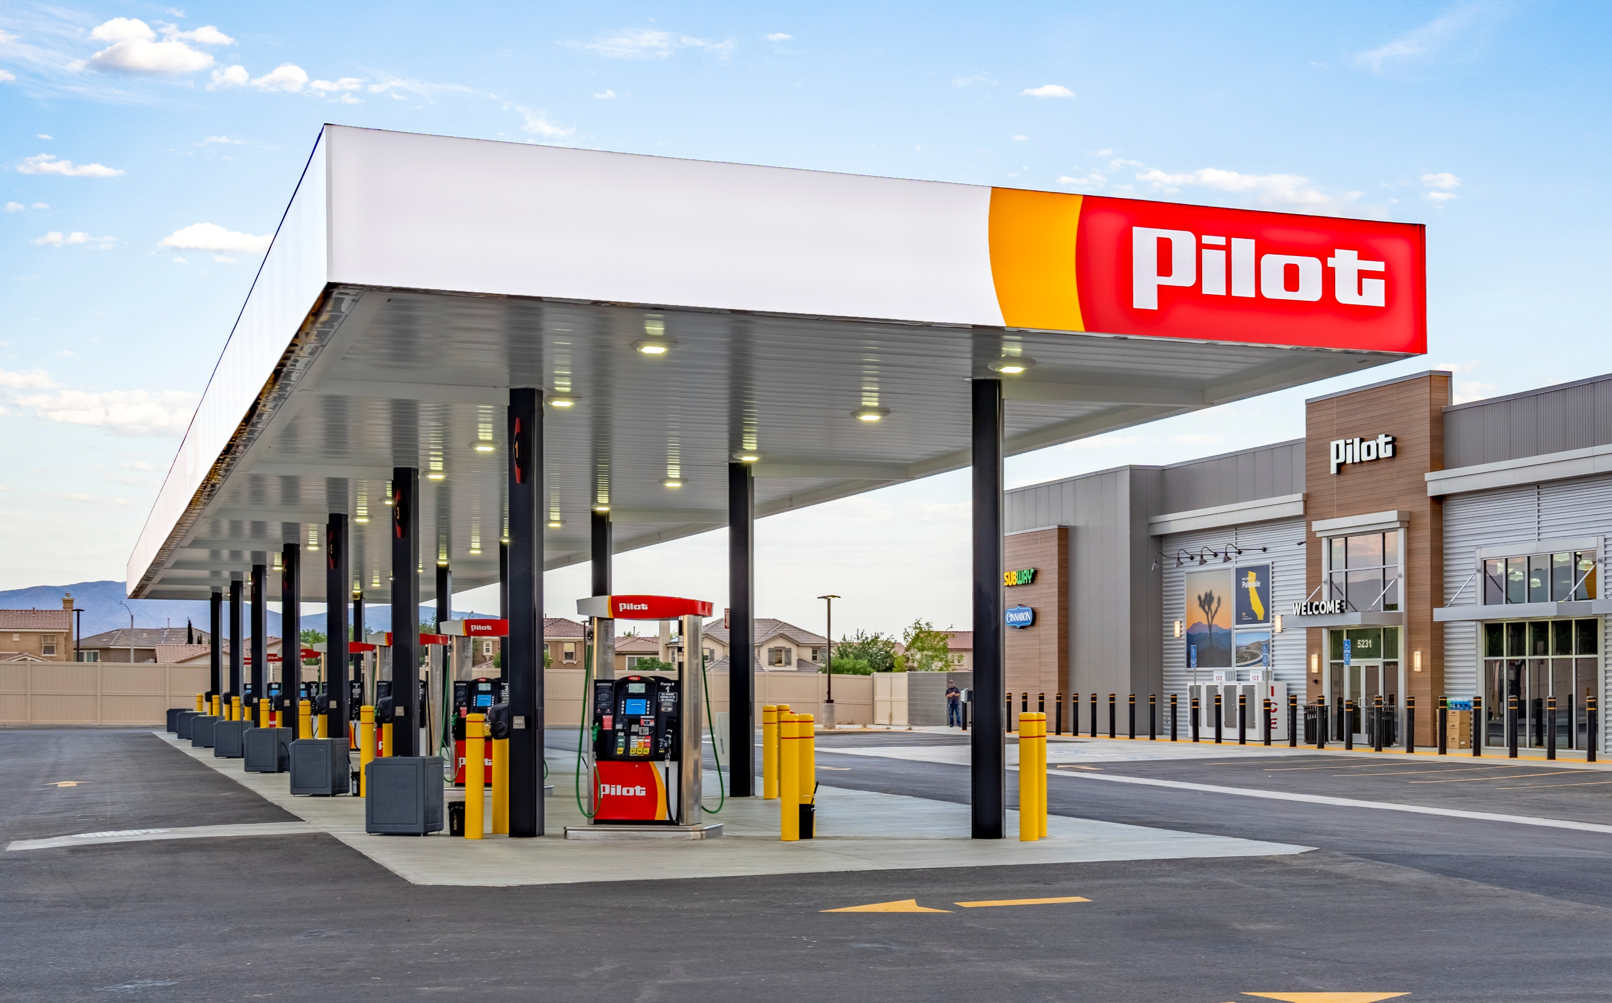
DARE TO COMPARE
ANTELOPE VALLEY
SANTA CLARITA
# OF SALES 219 58
PRICE/SF $158 $389
VOLUME $317M $253M
TOTAL SF 1.4M 1.6M
CAP RATE 6.3% 5.2%
MONTHS TO SALE 12.0 8.6

Slide 12
WANT TO KNOW MORE?
Seffi Toneman
Commercial Brokers Group
Broker-Owner
O. 661-600-1269
C. 661-609-0860
Seffi@CommercialBrokersGroupInc.com
www. CommercialBrokersGroupInc.com
@CommercialBrokersGroup

